Slide 1

Inspections

Slide 2
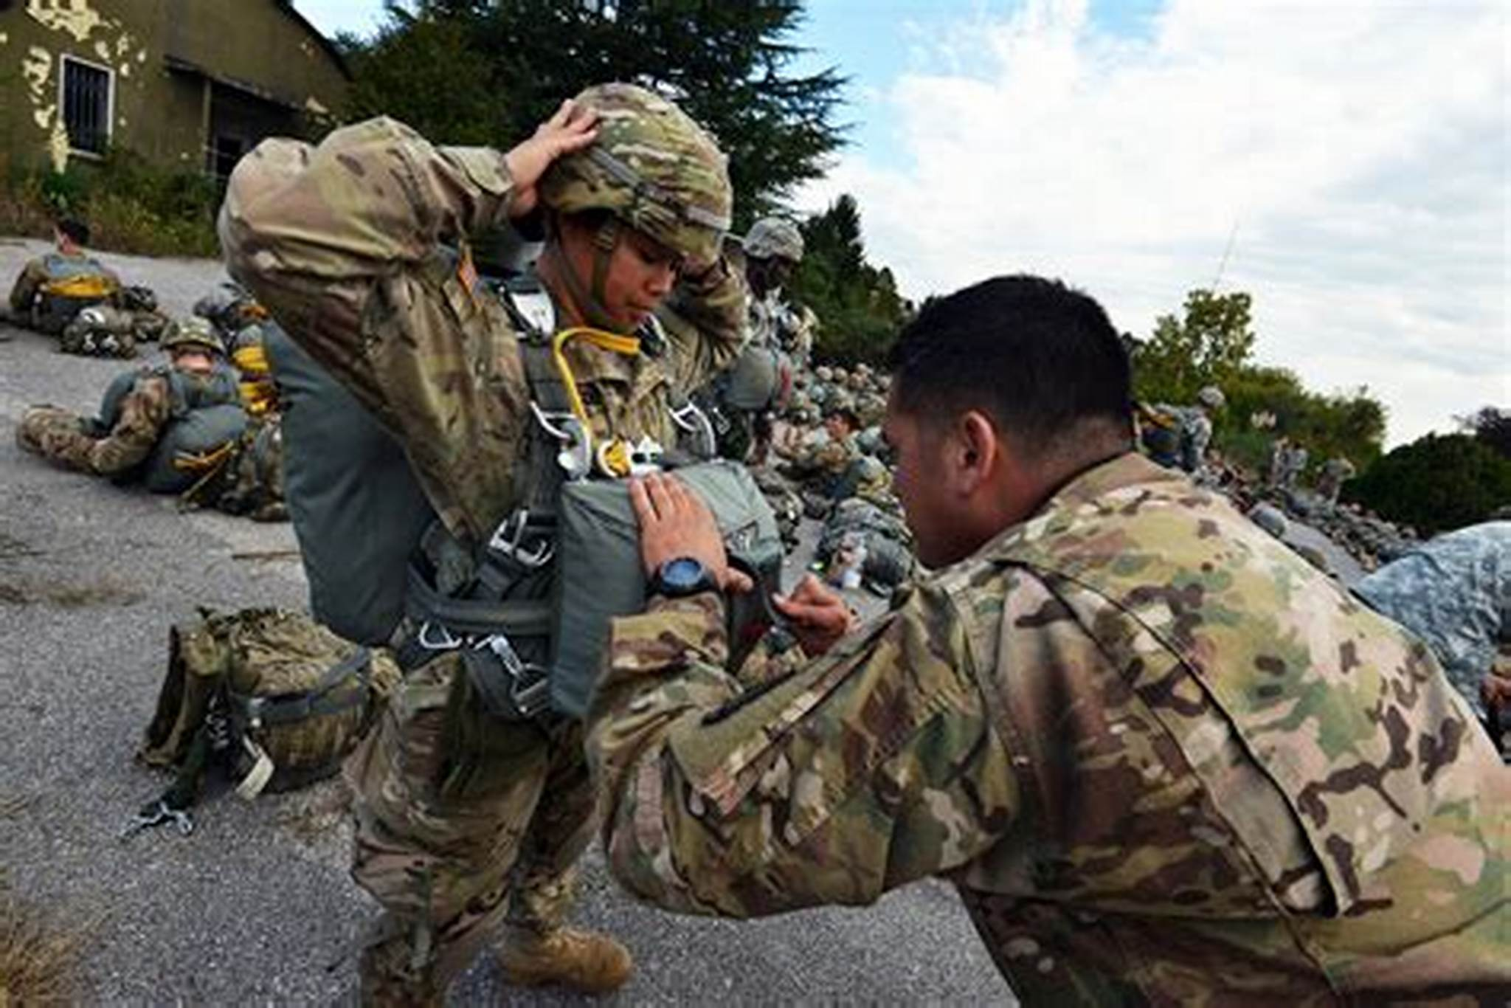
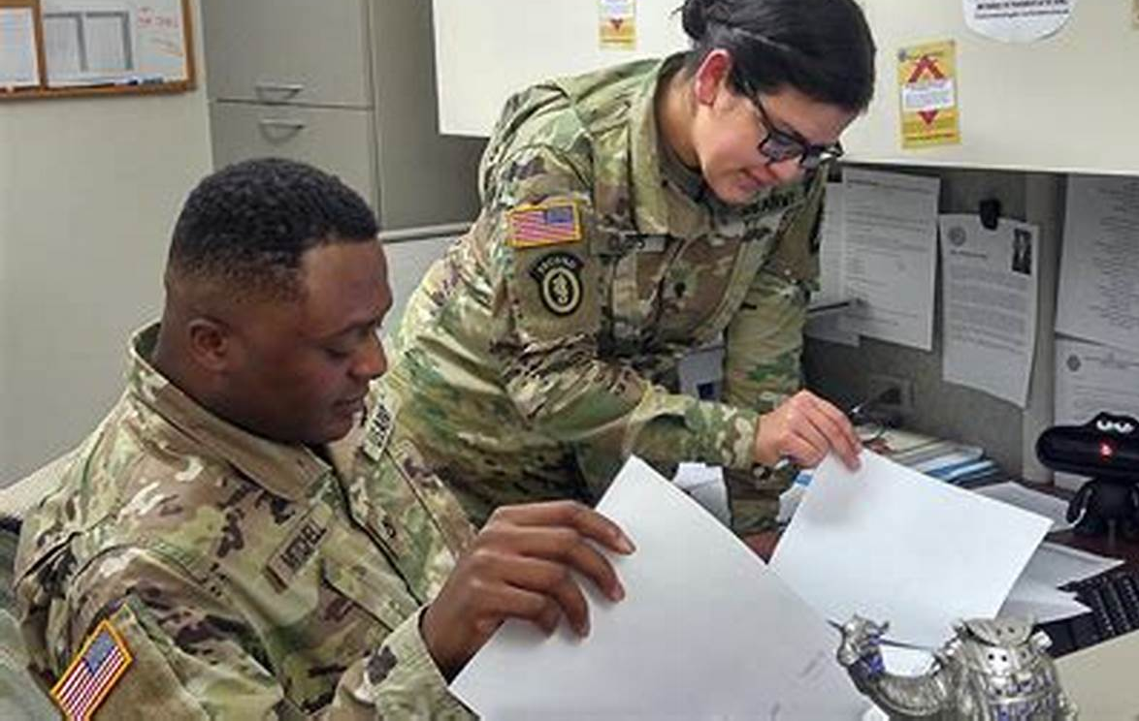
Inspections

Slide 3
Basic Ground Rules
All slides and guides are in Q: Class Material
This is not a briefing – participation is encouraged:
Please use your table microphones
Please leave cell phones in the student lounge
Please avoid personal Internet / email use and sidebar discussions during class time and Practical Exercises
We start on time

Slide 4
Squads
For all PEs, your squad represents the Fort Von Steuben IG Inspections Branch.
Refer to page 8-15 of The IG Reference Guide for a diagram of the IG office.
Become familiar with Fort Von Steuben and the 66th Infantry Division.

Slide 5
References
Army Regulation 1-201, Army Inspection Policy
Army Regulation 20-1, IG Activities and Procedures
The Inspections Guide
OIP Guide for Commanders (Q:)
Army Regulation 381-10, The Conduct and Oversight of U.S. Army Intelligence Activities (Q:)
The Intelligence Oversight Guide (Q:)
Advance Sheets
The IG Reference Guide, Part 8, Fort Von Steuben

Slide 6
Inspection’s Terminal Learning Objective (TLO)
Action: Resolve a systemic issue in a functional area.
Conditions: Given Army Regulation (AR) 1-201, AR 20-1, The Inspections Guide, Part 8 of The Inspector General Reference Guide, classroom handouts, classroom instruction, and an inspection topic.
Standard: Apply the 17 steps of the three-phased Inspector General Inspections Process, write a Findings Sections that accurately reflects the information gathered during the inspection, and describe the Organizational Inspection Program (OIP).

Slide 7
Enabling Learning Objectives (ELOs)
Reference: Advance Sheets Pages 8 – 10
  ** Questions for the Quiz and Final Exam
  will come directly from the ELOs! **
ELO

Slide 8
ELOs
ELO
Knowledge-based ELOs:
1. Define the following terms:
- Inspection
- Standard
- Initial Command Inspection (ICI)
- Subsequent Command Inspection (SCI)
- Root Cause
- In-Process Review (IPR)
- Crosswalk
- Handoff

Slide 9
ELOs
ELO
Describe the purpose of the Organizational Inspection Program (OIP).
Describe the IG’s role in the OIP.
Describe the five Inspection Principles.
Identify the three inspection categories.
Identify who may direct an IG Inspection.

Slide 10
ELOs
ELO
Describe the Root-Cause Analysis Model.
Identify the lowest level organization in which a commander has a staff to perform internal inspections on subordinate units as part of an OIP.
Describe the three phases of the Inspections Process and the key outputs associated with each phase.
Identify the five information-gathering domains.
Identify the five parts of the recommended findings section format.

Slide 11
ELOs
ELO
12. Identify which criteria must be met for local IGs to release written inspection reports for official use.
13. Describe the nature of Compressed IG Inspections.
14. Apply the three-phase, 17-step Inspections Process.
15. Apply the Root-Cause Analysis Model.
16. Complete a findings section using the appropriate information.
Application-based ELOs:

Slide 12
Safety and Environmental
Safety Requirements: No other specific safety requirements are unique to this block of instruction per DA PAM 385-30, Risk Management, dated 2 December 2014.
Risk Assessment Level: Low in accordance with TRADOC Regulation 385-2, U.S. Army Training and Doctrine Command Safety and Occupational Health Program, dated 14 June 2024.
Environmental Considerations: None in accordance with AR 200-1, Environmental Protection and Enhancement, dated 13 December 2007, and ATP 3-34.5, Environmental Considerations, dated January 2024.

Slide 13
Inspections Training Schedule
Day 2 (Tuesday)
  0800-1200 Inspection Principles & OIP
  1300-1600 Inspections Process
  Day 3 (Wednesday)
  0800-1500 Inspections Process
  1500-1700 Intelligence Oversight / DAIG IO Division
Day 4 (Thursday)
  0800-1130 Inspections Process
  ** Issue Graded Homework, due Day 6 (Monday) at 0800 **
  1230-1630 Inspections PEs (seminar rooms)
  1630-1700 ELO Review for Inspections Quiz

Slide 14
Inspections Training Schedule
Day 5 (Friday)
  0800-0830 Inspections Quiz
  0830-0900 Inspections Quiz Review
  Day 6 (Monday)
  NLT 0800 Inspections Homework Due
  Day 11 – 13 (Week 3)
  Inspections Extended Practical Exercise (EPE)

Slide 15
Army Inspection Policy
Army Regulation 1-201
Applies to all inspections (TIG = proponent)
Defines inspection terms and concepts
Provides broad guidance on how to conduct inspections
Outlines inspection principles
Identifies responsibilities
Establishes the OIP
Urges the integration of inspections

Slide 16
Why do inspections?
Proactively resolve issues that affect unit readiness and warfighting capability
Promote and reinforce good performance
Share best practices
Underscore leadership priorities
Provide information to Commanders so they can make decisions that improve readiness

Slide 17
Definition of an Inspection
ELO
1
An inspection is an evaluation that measures performance against a standard and should identify the cause of any deviation
A standard is the way things should be
  All inspections start with compliance against a standard
  Commanders tailor inspections to their needs
AR 1-201 (Glossary) &
The Inspections Guide (Section 2-3, pages 2-3-1 and 2-3-5)

Slide 18
Searching for Standards
Army Publishing Directorate (APD): https://armypubs.us.army.mil/
Army G-1 (Pentagon): http://www.armyg1.army.mil/
Department of Defense Directives: https://www.dtic.mil/whs/directives/
National Guard Bureau: https://www.ngbpdc.ngb.army.mil/
milSuite: https://www.milsuite.mil
Know the proponent for each regulation to fix responsibility.
Does the regulation apply to everyone in the Army?
Check the applicability of the regulation.

Slide 19
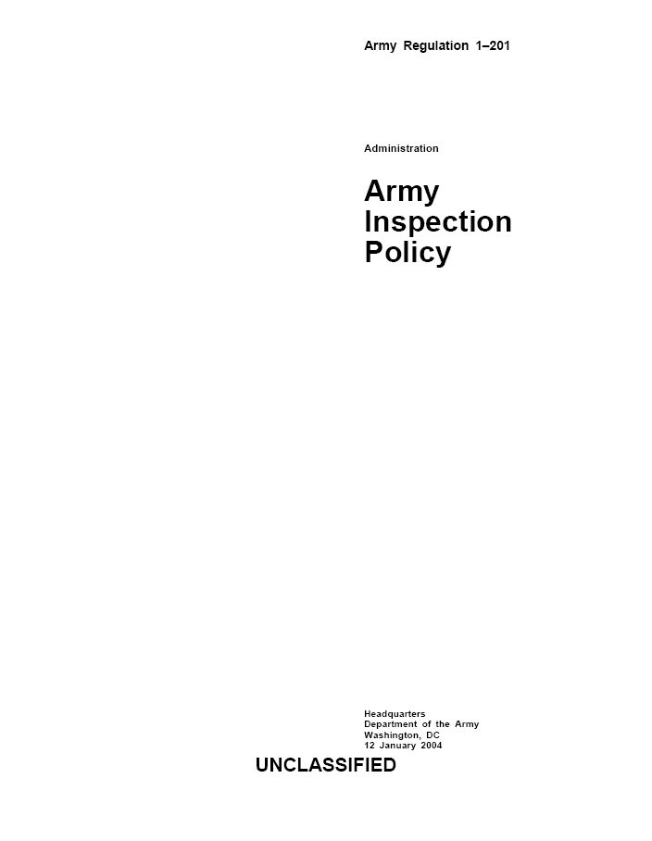
Principles of Army Inspections
ELO
4
1. Purposeful
2. Coordinated
3. Focused on Feedback
4. Instructive
5. Followed up
AR 1-201 (paragraph 2-2)

Slide 20
Principles of Army Inspections
1. Purposeful:
  The commander approves the specific purpose of the inspection.
    Related to mission accomplishment
    Tailored to meet the commander’s needs while remaining relevant and responsive
    Performance-oriented
    Start with an evaluation against a standard

Slide 21
Principles of Army Inspections
2. Coordinated
  To ensure the proper coordination of inspections, an annual review of all scheduled inspections should occur that answers the following questions:
    Can this inspection be canceled or combined with another inspection?
    Does this inspection duplicate or complement another inspection?
    Do inspection reports from other agencies or echelons exist that can assist in this inspection?

Slide 22
Principles of Army Inspections
3. Focused on Feedback
  Written inspection reports provide the commander / TAG / Program manager / Director with accurate and timely feedback AND allow for sharing of inspection results
  Findings
  Root causes
      Strengths and weaknesses
      Corrective actions

Slide 23
Principles of Army Inspections
4. Instructive
  Teaching and training is an essential element of all inspections.
    No inspection is complete if the unit or agency has not learned about goals / standards and how to achieve them.
    The overarching purpose of Staff Assistance Visits

Slide 24
Principles of Army Inspections
5. Followed up
  Inspections expend valuable resources; they are not complete unless the unit or agency develops and executes a follow-up plan to ensure implementation and progress of corrective actions.
    Follow-up can occur via:
      Re-inspection
      Telephone calls or visits to proponents
      Formal responses (Reply by Memorandum)

Slide 25
The Organizational
Inspection Program (OIP)
AR 1-201 (Chapter 3)
The Inspections Guide (Chapter 5)

Slide 26
Purpose of the OIP
ELO
2
To coordinate inspections and audits into a single, cohesive program focused on command objectives.
The OIP provides the commander with an organized management tool to identify, prevent, or eliminate problem areas.
AR 1-201 (para 3-2)

Slide 27
The Integration of Inspections
O I P
COMMAND INSPECTIONS
STAFF INSPECTIONS
IG INSPECTIONS
Staff Assistance Visits
External Inspections
Audits
Intelligence Oversight
Risk Management Internal Control
AR 1-201 (para 3-2 to 3-5)

Slide 28
Role of the OIP Coordinator
Develop and maintain the written OIP for the unit or command
Coordinate the execution of all inspection programs within the unit or command
Maintain a calendar or schedule of planned inspections
Serve as the executive agent for the Command Inspections (if required)
The Inspections Guide (page 5-4-1)

Slide 29
Role of the IG in the OIP
ELO
3
Develop the IG Inspection Program as part of the OIP
Advise and mentor commanders and staff on inspection policy
Advise the commander on their OIP’s effectiveness
Conduct IG Inspections
AR 20-1 (para 5-1)
AR 1-201 (para 1-4)

Slide 30
Categories of Inspections
ELO
5
O I P
COMMAND INSPECTIONS
STAFF INSPECTIONS
IG INSPECTIONS
AR 1-201 (para 3-2 to 3-5 )

Slide 31
Command Inspections
O I P
COMMAND INSPECTIONS
A scheduled, formal event
Led by the Commander
Initial Command Inspections (ICI)
Subsequent Command Inspections (SCI)
AR 1-201 (para 3-2 to 3-5)

Slide 32



Initial Command Inspections
ELO
1
Identify the unit’s strengths and weaknesses
Helps commanders establish goals, standards, and priorities
Cannot be used to:
  evaluate the Commander
  compare units
  Only the inspected commander and that commander’s rater will receive the specific results (IG can request results without unit attribution)
CDR
XO
AR 1-201 (para 3-3)

Slide 33
Initial Command Inspections
ELO
1
Required for Company Commanders (or similar commands: detachments, troops, batteries)
Inspecting Commander must be present and participate in the inspection (USAR & ARNG consider consolidating inspections to facilitate presence / participation)
Timing:
      Within 90 days of change of command for Active Duty
      Within 180 days of change of command for National Guard (NG) and U.S. Army Reserve (USAR)
AR 1-201 (para 3-3)

Slide 34
Subsequent Command Inspections (SCI)
ELO
1
Measures progress and reinforces goals and objectives established during the ICI
Ensures the implementation of corrective actions and the continued assessment of readiness
Required for Company Commanders (or like commands)
Normally occur within one (1) year of completing the ICI
The inspecting commander may use the results of the SCI to evaluate the Company Commander
AR 1-201 (para 3-3)

Slide 35
Staff Inspections
O I P
STAFF INSPECTIONS
Compliance-oriented
Usually focused on a single functional area
Conducted by the lowest-level staff member technically qualified in functional area
Complements Command and IG Inspections
Staff Inspections
Staff Assistance Visits (SAV)

Slide 36
Staff Assistance Visit (SAV)
Directly support Staff and Command Inspections
Teach and train subordinate staff sections on how to meet the required standards of a particular functional area
Can prepare staff sections for upcoming inspections or train them on new concepts, technologies, or operating techniques

Slide 37
IG Inspections
O I P
IG INSPECTIONS
  Pursue systemic issues
  Identify the root cause
  Teach systems processes and procedures
  Identify responsibility for corrective actions
  Spread innovative ideas

Slide 38
Systemic vs Local Problems
What is the difference?
Systemic problems are usually widespread and present a pattern. You can often trace these back to a regulation, policy, or standard that is confusing, overly ambitious, or in conflict with another standard. The proponent is usually the person to fix these problems.
Local problems usually affect a small group of people or an individual and do not present a pattern. You can usually trace these back to a particular person’s decision, demeanor, or statements. The organization / level the problem affects is the usually best to fix these problems.

Slide 39
Systemic vs Local Problems
Several Soldiers in Company C, 3rd Battalion, 66th Infantry, failed to receive their Basic Allowance for Subsistence (BAS) in their End-of-Month (EOM) pay.
Is this problem systemic or local?
LOCAL

Slide 40
Systemic vs Local Problems
A lieutenant recently conducted a Permanent Change of Station (PCS) from Germany to Fort Von Steuben. Sixty days have passed, and he has still not received his household goods.
Is this problem systemic or local?
LOCAL

Slide 41
Systemic vs Local Problems
For the past six months, 31 percent of the Army National Guard Soldiers mobilized to Fort Von Steuben’s Power-Projection Platform are found to be Dental Category 3 or 4 (Non-deployable). Twenty-five percent of the U.S. Army Reserve Soldiers are also Dental Cat 3 or 4 upon arrival to Fort Von Steuben.
Is this problem systemic or local?
SYSTEMIC

Slide 42
Who May Direct an IG Inspection?
ELO
6
ELO
6
1) Secretary of the Army (SA)
2) Under Secretary of the Army
3) Chief of Staff of the Army (CSA)
4) Vice Chief of Staff of the Army (VCSA)
5) The Inspector General (TIG)
6) Commander (Directing Authority)
Inspection Directive
AR 20-1 (Glossary)

Slide 43
Why do units and people fail to comply with standards?
What are some reasons you may have heard?
“That is the way we did it in my old unit.”
“I have no idea what you are talking about. I have been the S-1 for only two days.”
“Take a number. We have two CTC rotations, an OEF planning conference, and BDE formal in front of you.”
“I can’t get any good help these days. I am on my butt because all my staff officers are young LTs!”
“I don’t understand … I thought I understood ... I did it right the last time, but …”

Slide 44
Root Cause
Root Cause: The underlying reason why something does or does not happen.
Every problem has a root cause.
Apply the Root Cause Analysis (RCA) Model to any inspection to determine why a unit or individual is not complying with a standard.
The RCA Model helps inspectors think through all the reasons why something is / is not happening.
The Inspections Guide (page 3-3-1)

Slide 45
The Root Cause Analysis Model
ELO
7
Root Cause: The underlying reason why something does or does not happen.
NON-COMPLIANCE
DON’T KNOW
CAN’T COMPLY
WON’T COMPLY
NEVER KNEW
FORGOT
TASK IMPLIED
FEW RESOURCES
DON’T KNOW HOW
IMPOSSIBLE
NO REWARD
NO PENALTY
DISAGREE
The Inspections Guide (Sect 3-3, pages 3-3-1 to 3-3-3)

Slide 46
Don’t Know
Why not?
Never knew – The problem may be systemic in terms of getting guidance down to the user level.
Forgot – The problem is usually a local or personal issue.
Task implied – The problem could result from a lack of experience or specific guidance.
Look for written SOPs, regulations, policies, and so on.

Slide 47
Can’t Comply
Why not?
Scarce resources / low priority – Always look at the big picture.
Don’t know how – Unit or individual knows the requirement but does not know how to execute – possibly a lack of training.
Impossible – The unit or individuals may not even be able to accomplish the task.

Slide 48
Won’t Comply
Why not?
No reward – Check for incentives.
No penalty – Nobody cares.
Disagree – The unit or individual may be seeking an exception to policy or a change to the rules.

Slide 49
START
Root Cause Analysis as a Flow Chart
COMPLIANCE?
MEETS STANDARD?
YES
GOOD NEWS!
SPREAD IT
AROUND!
NO
YES
YES
THEN THEY
CHOSE NOT
TO COMPLY
WHAT ARE THE
REWARDS
FOR MEETING
THE STANDARD?
KNOWS ABOUT
REQUIREMENT &
STANDARD?
SUFFICIENT
RESOURCES?
Try the 5 why analysis
NO
NO
ROOT CAUSE
MAY BE:
NEVER KNEW
IMPLIED TASK
FORGOT
WHICH RESOURCE IS LACKING?
TIME? MANPOWER?
MONEY? EQUIPMENT?
FACILITIES? KNOWLEDGE?
WHAT ARE THE
PENALTIES
FOR NOT MEETING
THE STANDARD?
WHY DID
THEY CHOOSE
NOT TO
COMPLY?
WRITE AN APPROPRIATE
ROOT CAUSE AND
RECOMMENDATION
STOP

Slide 50
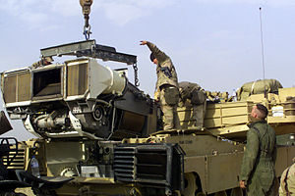
Root Cause
Case Study 1
During morning formation, drivers were informed of requirement to conduct Preventive Maintenance Checks and Services (PMCS).
Despite knowing the standard, they are not conducting PMCS to standard. The drivers say they haven’t been taught how to conduct PMCS.

Slide 51
Root Cause
Case Study 1
Drivers know they are supposed to conduct PMCS but haven’t been taught how to execute.
What is the standard (BLUF)?
Perform PMCS on their respective vehicles.
Root Cause:
  Can’t Comply. Drivers are non-compliant because they don’t know how to conduct PMCS.

Slide 52
Root Cause
Case Study 1b
What if… The drivers (junior Soldiers) know how to conduct PMCS but there are no NCOs in the motor pool to enforce the standard. Thus, the drivers take advantage of the free time to play Minecraft.
What is the standard?
Perform PMCS on their vehicles.
Root Cause:
  Won’t Comply. Drivers are non-compliant due to no penalty.

Slide 53
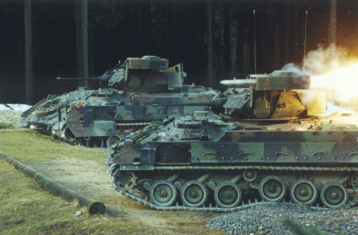
Root Cause
Case Study 2
Twenty percent of an infantry battalion’s vehicle fleet is suffering from Class II oil leaks.
The drivers say they were trained to tighten the bolts, wipe off the spot, and keep an eye on the leak.

Slide 54
Root Cause
Case Study 2
Twenty percent of an infantry battalion’s vehicle fleet is suffering from Class II oil leaks. The drivers are trained to tighten the bolts, wipe off the spot, and keep an eye on the leak.
What is the standard (BLUF)?
Tighten, wipe, and observe.
Root Cause:
  Not Applicable. Drivers are compliant with the standard. Thus, non-compliance is not the cause of the vehicles’ oil leaks = good news story!

Slide 55
Types of Inspections
General Inspection: Broad in scope, oriented on units, and designed to look at all aspects of the organization. (Once called compliance inspections)
Special Inspection: Focused on specific functions, programs, procedures, problems, or issues; also look at groups of related problems or procedures. The special inspection facilitates the systemic approach to an inspection and is the preferred type of IG Inspection.
Follow-up Inspection: These inspections review the effectiveness of corrective actions taken as a result of a previous inspection.
The Inspections Guide (Sect 2-3, pages 2-3-2 to 2-3-3)

Slide 56
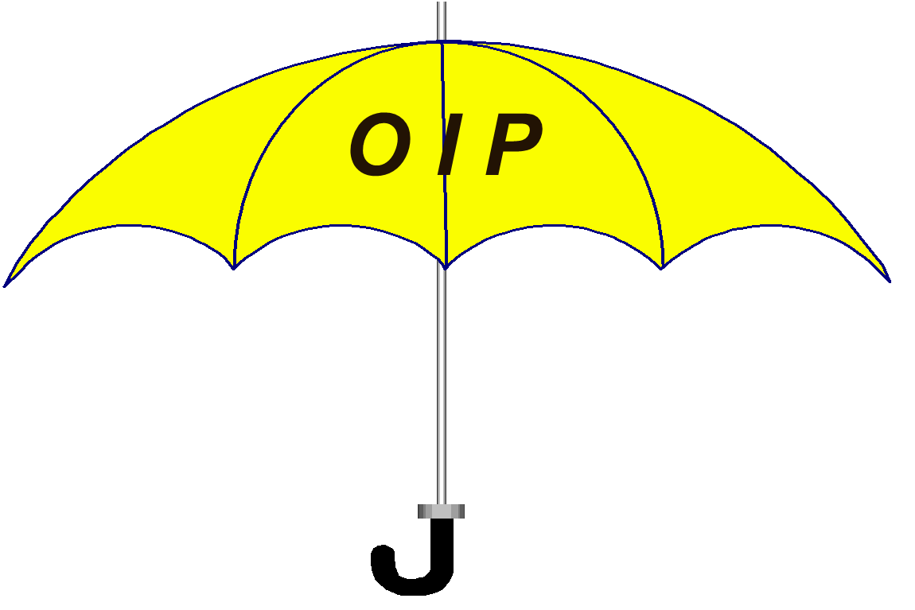
COMMAND
INSPECTION
STAFF
INSPECTION
IG INSPECTION
General
Special
Follow-up
General
Special
Follow-up
Special
Follow–up
General
All three inspection categories can contain the three types of inspections.

Slide 57
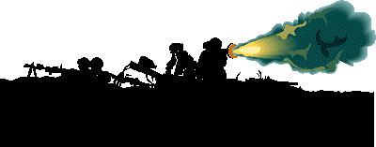
OIP: Battalion
ELO
8
The battalion is the lowest level organization in which a commander has a staff to perform internal inspections on subordinate units as part of an OIP.
The Battalion OIP normally includes Command Inspections (Initial and Subsequent) and Staff Inspections
The Battalion OIP focuses on areas that immediately impact readiness and reinforce goals and standards
Teaching, training, and mentoring is a goal of company-level Command Inspections
AR 1-201 (para 3-2)

Slide 58
OIP: Brigade
At a minimum, the Brigade OIP:
  Will include guidance on Command Inspections, Staff Inspections, and SAVs
  Should include inspections of the brigade headquarters company
  Should focus on units and functional areas
The Brigade OIP must complement the battalion commanders’ programs and avoid redundancy

Slide 59
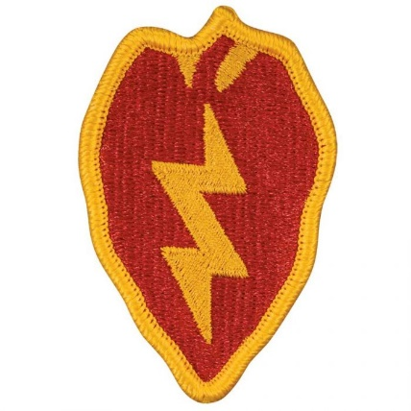







OIP: Division
The Division OIP consists primarily of Staff Inspections, SAVs, and IG Inspections
At a minimum, the Division OIP must:
  Establish a plan to check the OIP’s effectiveness (an IG role)
  Protect subordinate commanders from being over-inspected
  Incorporate Intelligence Oversight Inspections
  Disseminate lessons learned

Slide 60
Developing an OIP
Your unit or command’s OIP will normally exist in the form of a local regulation or memorandum.
The OIP document should list responsibilities for staff members and subordinate commanders and designate an overall OIP Coordinator.
The Inspections Guide (Chapter 5)

Slide 61
Developing an OIP
The OIP memo should articulate the commander’s overall inspection guidance.
The OIP document should address the relevant categories of inspections (Command, Staff, and IG) – as they pertain to the command – by frequency, focus, and so on.

Slide 62
Developing an OIP
The OIP document should address Intelligence Oversight within the unit or command.
The OIP document must capture all inspections that affect the command and then prioritize them – or eliminate some of them!
The OIP document should establish the scope and standards for the different types of inspections.

Slide 63

The IG Inspection Selection Process:
The Inspections Guide (Section 3-4)

Slide 64
The IG Inspection Selection Process:
Determine your commander’s priorities.
1. DETERMINE
THE COMMANDER’S
PRIORITIES
The IG must know the Command / Commander:
  Attend relevant staff meetings and listen in on key topics
  Keep up with the commander’s philosophy and vision
  Review Command Policies and Goals, Annual Training Guidance
  Study pertinent issues in Unit Status Reports or Strategic Readiness System (SRS)
Be a visible and participating member of the command
Review the IG Database for trends
Review DAIG and higher HQ’s inspection priorities

Slide 65
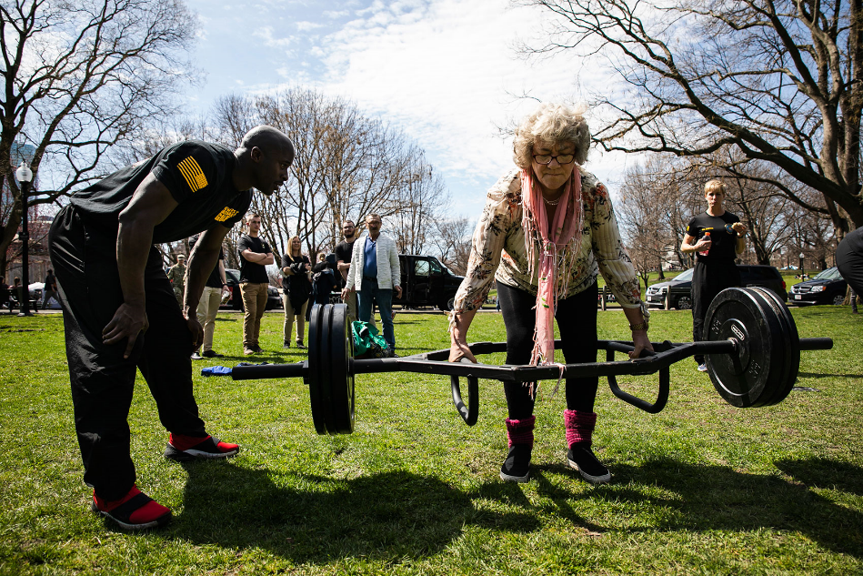
The IG Inspection Selection Process: Analyze information for...
2. ANALYZE
INFORMATION
Impact on Unit Readiness
Value to the Command
Priority to the Commander
Interesting, but does it matter?

Slide 66
The IG Inspection Selection Process: Develop a Prioritized List
List the inspection topics by priority
Recommend developing at least four key inspection topics for the fiscal year (one topic per quarter)
Explain to the commander how and why these inspections will contribute to unit readiness
For example:
3. DEVELOP THE LIST
FYSA: PE
Inspection Topic
1. OIP (1st Quarter)
2. Risk Management (RM) (2nd Quarter)
3. Force Protection (3rd Quarter)
4. Property Accountability (4th Quarter)

Slide 67
The IG Inspection Selection Process: Gain Approval and Plan
Present the topics to your commander for approval
Schedule the inspections
Notify the command
5. SCHEDULE
4. COMMANDER
APPROVES LIST

Slide 68
The Inspection Selection Process
CONSIDER THE COMMANDER’S
GUIDANCE AND CURRENT TRENDS
1. DETERMINE
COMMANDER’S
PRIORITIES
2. ANALYZE
INFORMATION
4. COMMANDER
APPROVES LIST
3. DEVELOP THE LIST
1. OIP
2. Risk Management
3. Force Protection
4. Property Accountability
5. SCHEDULE
6. NOTIFY THE
COMMAND /
PUBLISH THE LIST

Slide 69
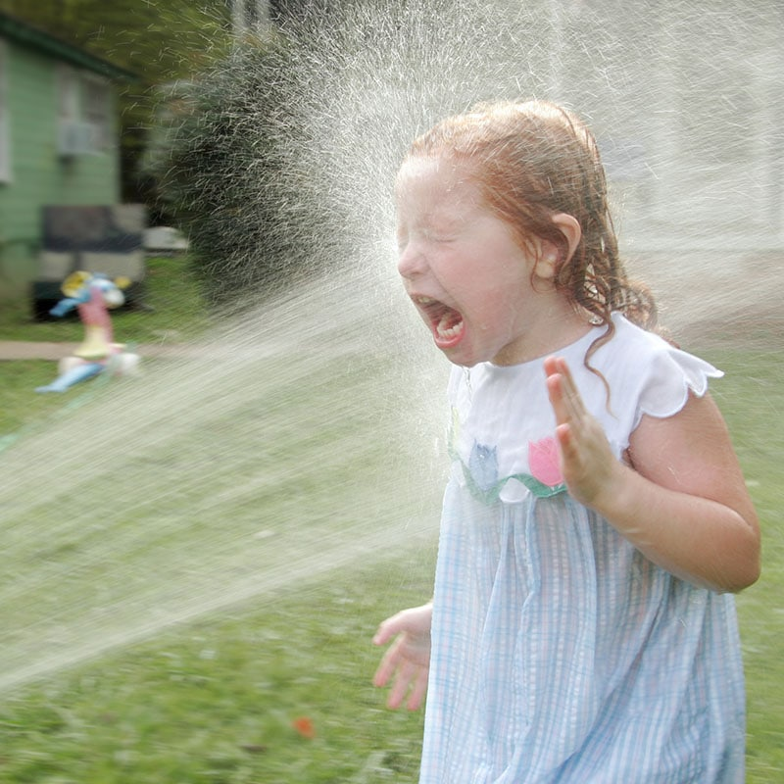
The Inspections Process

Slide 70
References
Army Regulation 20-1, Inspector General Activities and Procedures
Army Regulation 1-201, Army Inspection Policy
The Inspections Guide
The Inspections Process Diagram

Slide 71
The Inspections Process
RESEARCH
DEVELOP CONCEPT
PLAN IN DETAIL
TRAIN UP
PREPARATION
1
2
CDR
4
5
APPROVES CONCEPT
3
PRE-INSPECTION VISITS
6
IPR
8
ANALYZE
RESULTS
CROSSWALK
OUT-BRIEF PROPONENT
VISIT UNITS
EXECUTION
7
UPDATE CDR
10
11
9
OUT-BRIEF CDR
FINALIZE REPORT
DISTRIBUTE REPORT
SCHEDULE FOLLOW-UP
COMPLETION
12
TASKERS
14
16
17
HANDOFF
13
15
The Inspections Guide, Chapter 4

Slide 72
The Inspections Process
Three Phases
ELO
9
Preparation Phase
Execution Phase
Completion Phase
The Inspections Guide (page 4-1-1)

Slide 73

The Inspections Process
Phase One: The Preparation Phase
RESEARCH
DEVELOP CONCEPT
PLAN IN DETAIL
TRAIN UP
1
2
CDR
4
5
APPROVES CONCEPT
3
PRE-INSPECTION VISITS
6
The Inspections Guide (Sect 4-2)

Slide 74
Research
Conducting research on the inspection topic is the most important step of the whole inspection.
In order to conduct research successfully:
  Consider Directing Authority and Command IG’s guidance on topic (narrows scope)
  Determine applicable standards and gather all available information (e.g., regs, FMs, etc.)
  Study the results of previous IG inspections on the same / similar topic. DAIG inspections found at: (select TIG from dropdown) https://armypubs.army.mil/ProductMaps/PubForm/PogProponent.aspx
  Request brief / interview with proponent or subject-matter expert (SME)

Slide 75
Research
Define the System
What system, program, or process are you are planning to inspect?
Functional Model: Graphically depicts the decisions, actions, and activities of a system, program, or process in order to describe and understand its functional aspects.
Includes the following components:
  Controls – Elements that define or constrain how to conduct the activity. Examples are laws, regulations, policies, etc.
  Inputs – Elements transformed by the activity or process. Inputs normally include people, systems, facilities, or equipment.
  Mechanisms – Those things that are necessary to accomplish the activity. Mechanisms are the specific “who” does “what” within the system / process.
  Output – The results or desired end state of the activity.

Slide 76
Research
Functional Model
Allows IG to see
a complete picture of the inspection topic
System / Program / Process
Controls
dictate inputs, mechanisms,
and outputs
Controls:
Laws, regulations, policies, etc., that govern the process -- include proponent
Inputs:
People, systems, facilities, or equipment to be transformed during the process
Mechanisms:
Specific activities necessary to perform the process
(i.e., transform the inputs into the output)
Who What
Output:
Desired result of the system / program / process

Slide 77
Research: Example Functional Model
We’ve got a problem!
Background: Mod Pizza – It’s a fancy pizza restaurant that provides made-to-order goodness in their wood-fired pizza oven.
Situation: Suddenly, all the pizzas are coming out of the oven burnt and they don’t know what to do. Business is suffering. Their team needs to figure out which part of the pizza baking process is failing to resolve the issue and resume normal operations.
Way Ahead: The IG team will conduct research and build a functional model of the pizza baking process. Right now, we are ONLY defining the system as outlined in the regulation(s) / policies / etc.
*** Once we understand what right looks like, we can figure out where the system is breaking down… but let’s not get ahead of ourselves. ***

Slide 78
Research: Example Functional Model
System / Program / Function:
Baking a Mod Pizza
Controls:
Inputs:
Mechanisms:
Who:
What:
Outputs:

Slide 79
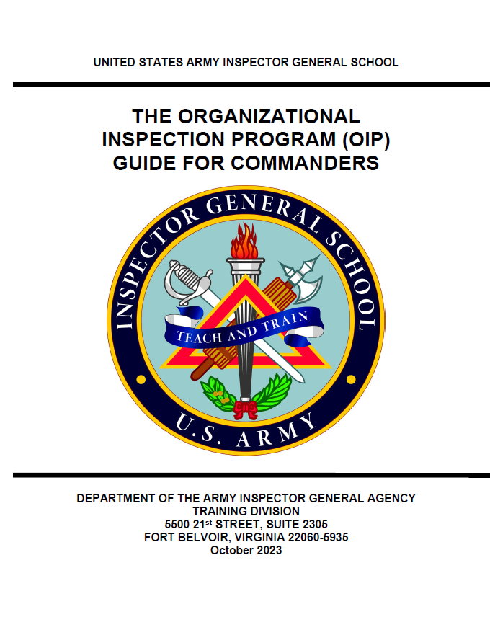
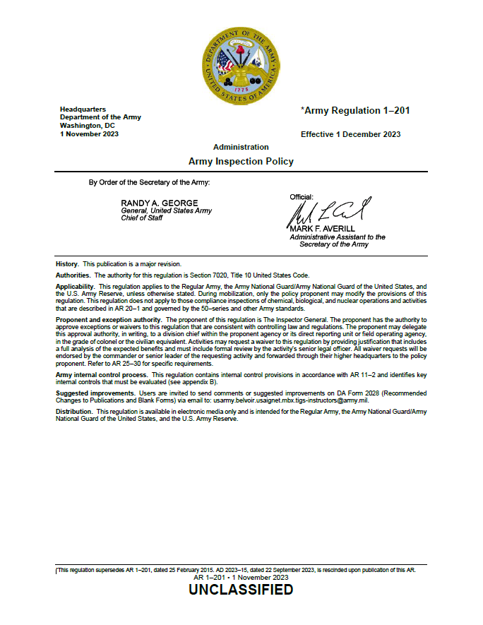
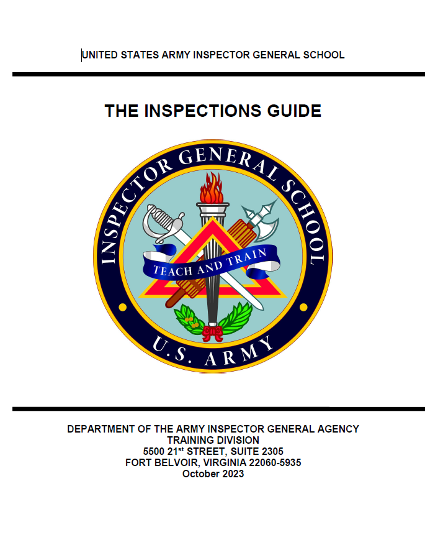
Research: Example Functional Model
Let’s Break it Down
System / Program / Function:
Baking a Mod Pizza
Controls:
TM 1-P Wood Fired Pizza Ovens ((Headquarters Mod Pizza (HQMP), P-3)
Top-Secret Pizza Recipes (HQMP, P-4)
Mod Pizza Employee Handbook (HQMP, P-1)
Mod Pizza, Technical
Manual, TM 1-P, WOOD
FIRED PIZZA OVENS
Mod Pizza
Employee Handbook
Top-Secret Pizza Recipes

Slide 80
Research: Example Functional Model
Let’s Break it Down
Inputs (i.e., ingredients to be transformed):
Snazzy crust, pepperoni, mushrooms, sausage, and extra cheese
Snazzy Crust
Extra cheese
Pepperoni
Sausage
Mushrooms

Slide 81
Research: Example Functional Model
Mechanisms:
Who:
What:
Manager
Responsible for inventory management and supplier coordination / ordering; budget / accounting; safety and hygiene; communication; problem-solving; staff training; oversight of all shop operations
Head Pizza Chef
Responsible for managing pizza cooks; advises Manager on quality ingredients vs profitability; equipment calibration and maintenance
Pizza Cooks
Responsible for following Head Chef’s guidance; following recipes; ingredient preparation (e.g., toss dough, assemble pizza, cook, etc.)

Slide 82
Research: Example Functional Model
Output (i.e., ingredients are successfully transformed):
Ooey, gooey, hot (but not burnt) wood fired pizza

Slide 83
Example Functional Model
System / Program / Function:
Baking a Mod Pizza
Controls:
TM 1-P Wood Fired Pizza Ovens ((Headquarters Mod Pizza (HQMP), P-3)
The Book of Top-Secret Pizza Recipes (HQMP, P-4)
Mod Pizza Employee Handbook (HQMP, P-1)
Inputs:
Snazzy crust, secret sauce, cheese, toppings
Mechanisms:
Who:
What:
Manager
Responsible for inventory management and supplier coordination / ordering; budget / accounting; safety and hygiene; communication; problem-solving; staff training
Head Pizza Chef
Responsible for managing other cooks; advises Manager on quality ingredients vs profitability; equipment calibration and maintenance
Pizza Cooks
Responsible for following Head Chef’s guidance; following recipes; ingredient preparation (e.g., toss dough, assemble pizza, cook, etc.)
Outputs:
Ooey, gooey, hot (but not burnt) wood fired pizza

Slide 84
Example Functional Model #2
System / Program / Function:
Risk Management
3. DEVELOP THE LIST
Controls:
Laws, regulations, policies, etc., that govern the process -- include proponent
1. OIP (1st Quarter)
2. Risk Management (RM) (2nd Quarter)
3. Force Protection (3rd Quarter)
4. Property Accountability (4th Quarter)
Inputs:
People, systems, facilities, or equipment to be transformed during the process
Mechanisms:
Specific activities necessary to perform the process
(i.e., transform the inputs into the output)
Who What
Output:
Desired result of the system / program / process

Slide 85
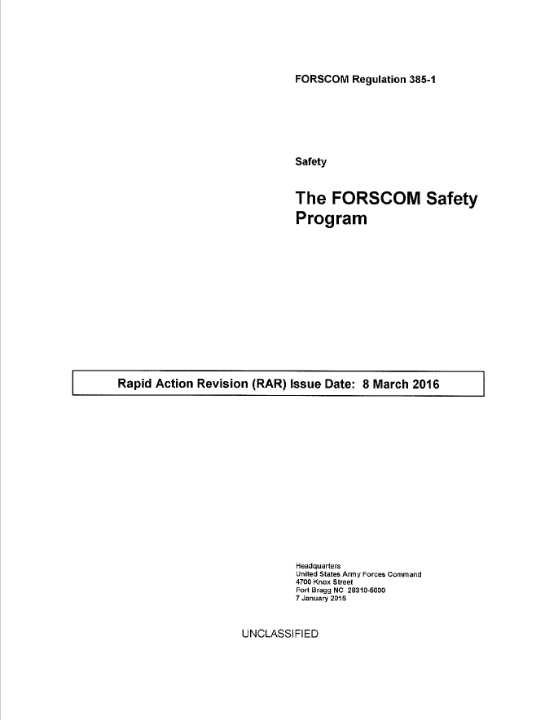
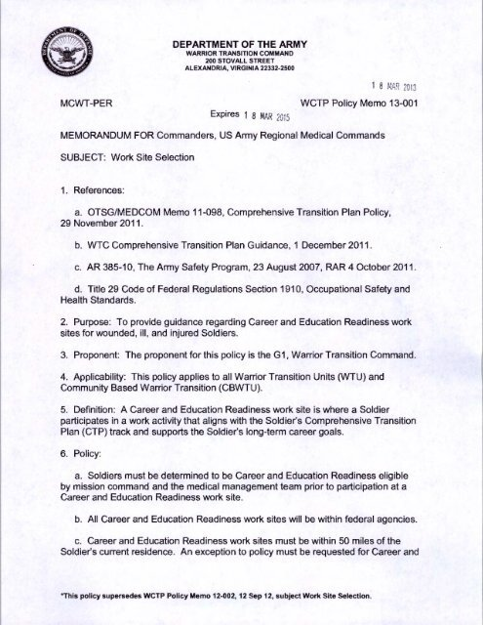
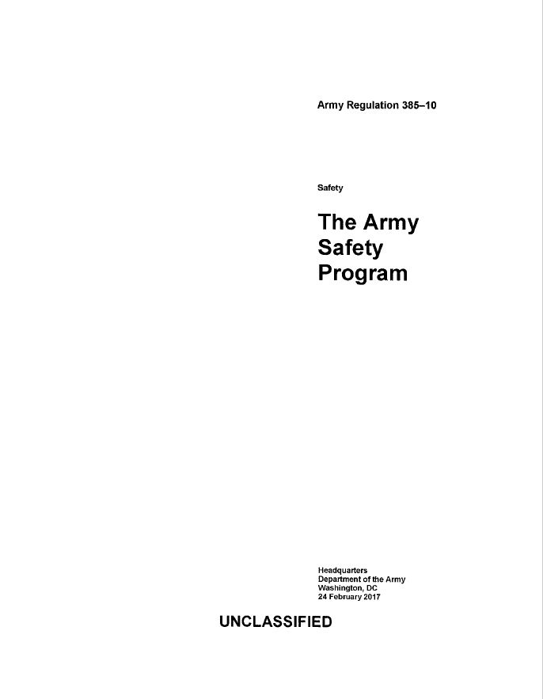
Example Functional Model #2
Let’s Break it Down
System / Program / Function:
Risk Management
Controls:
AR 385-10, Army Safety Program, (DAS)
FORSCOM REG 385-1 (G-1, ACOM)
Local Policy / Guidance (Senior Mission CDR)
Policy Memo 1-001
Subject: The Safety Program

Slide 86
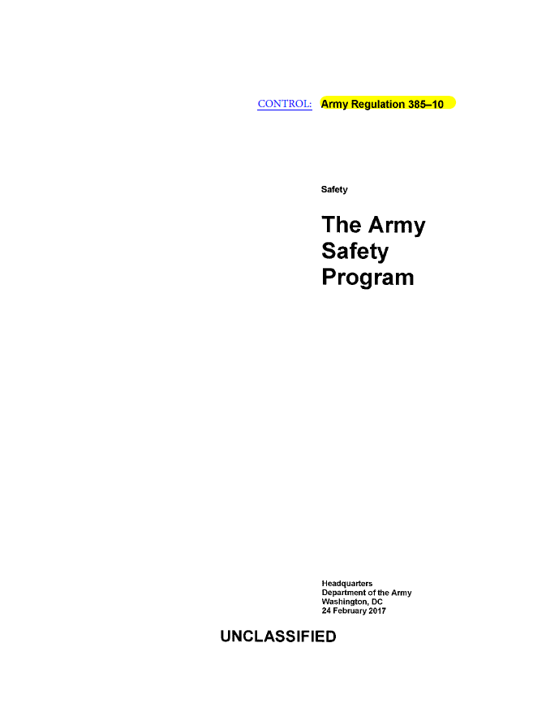
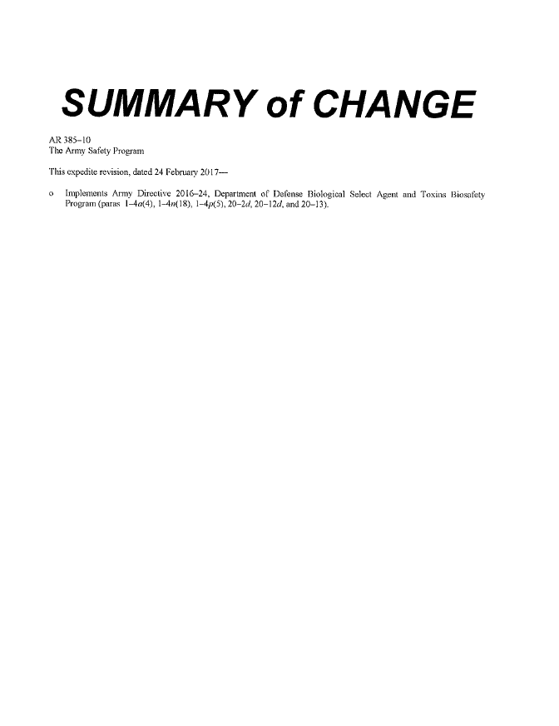
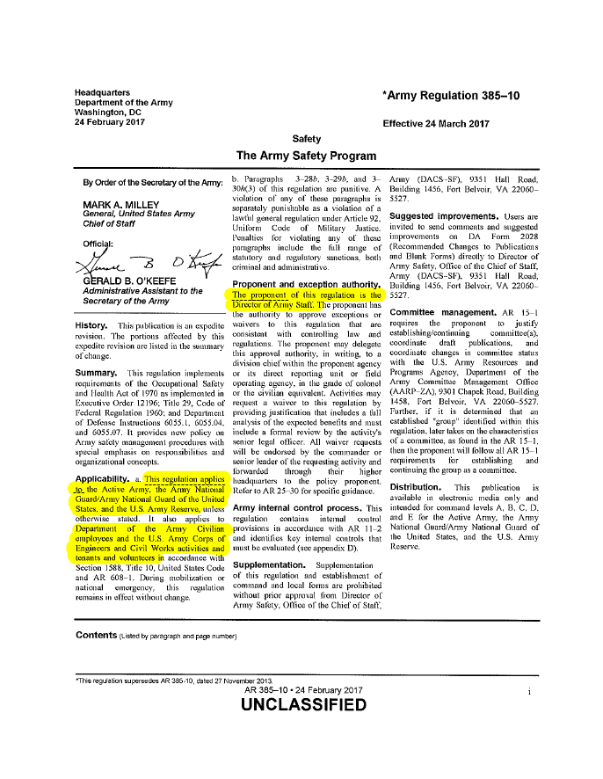
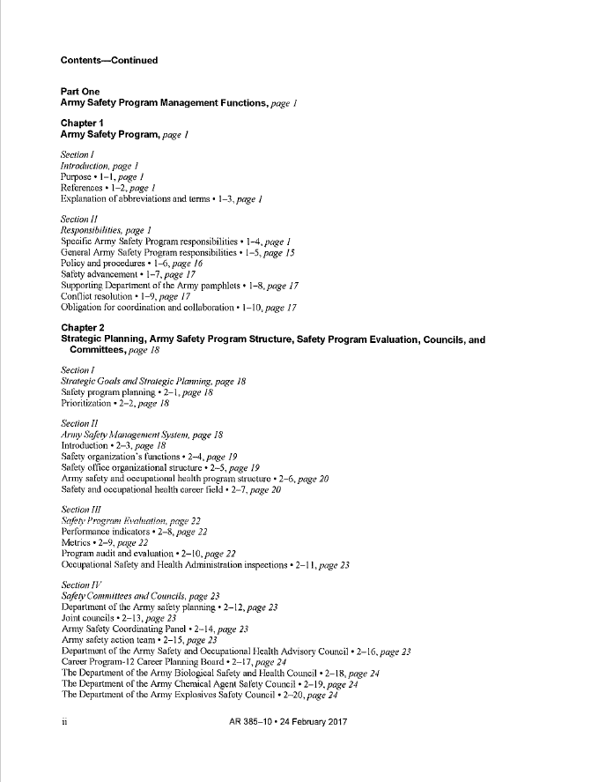
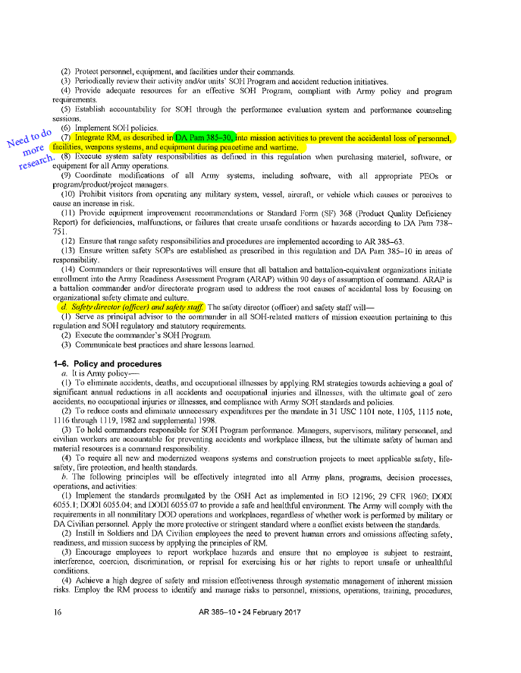
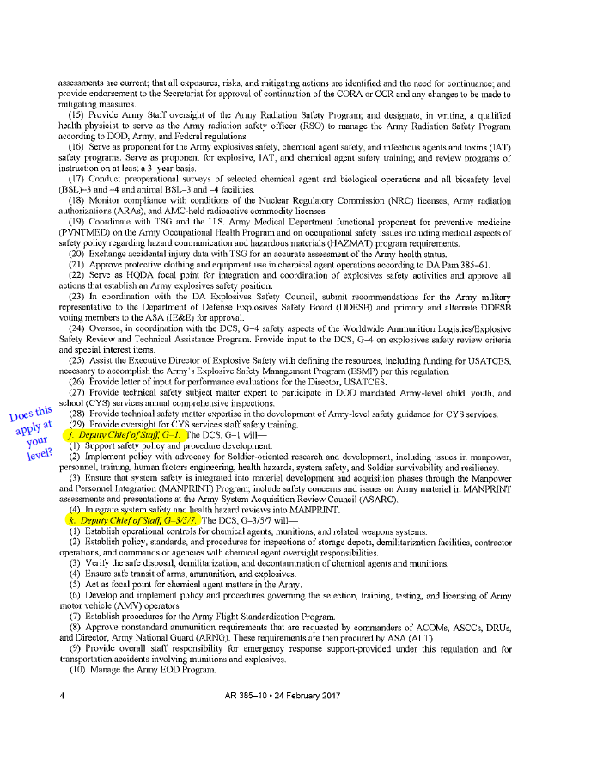
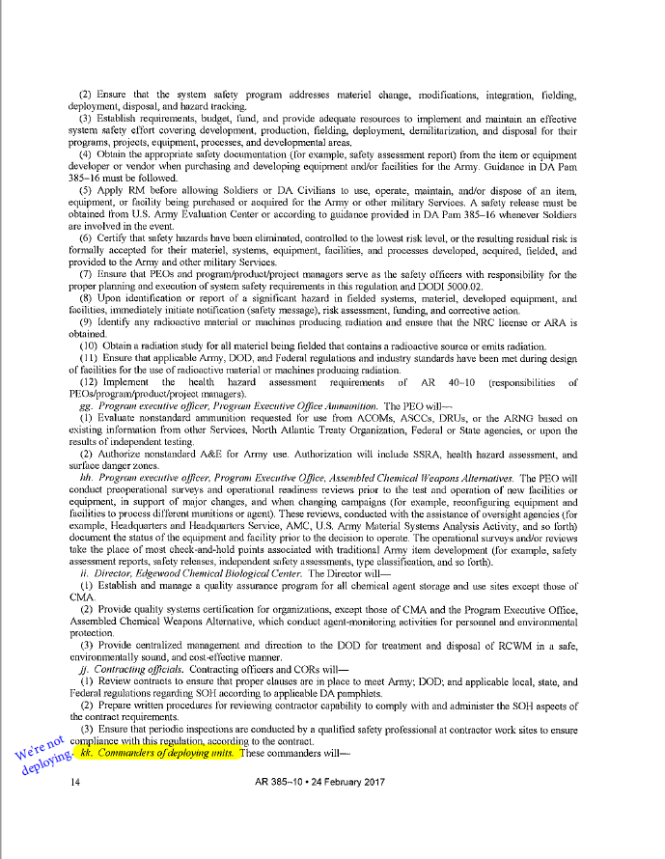
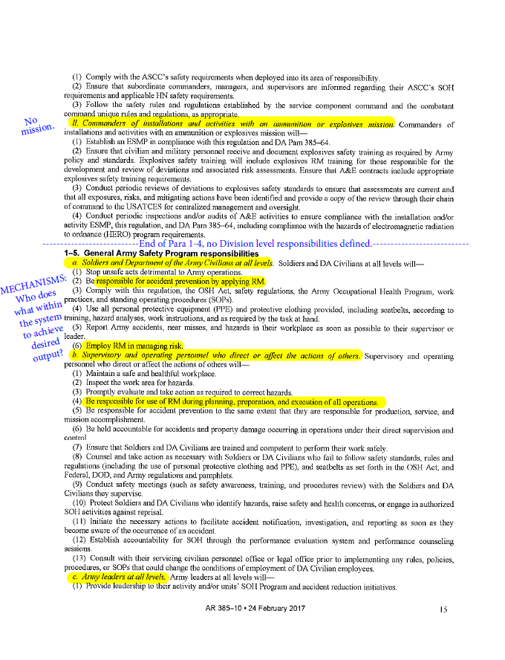
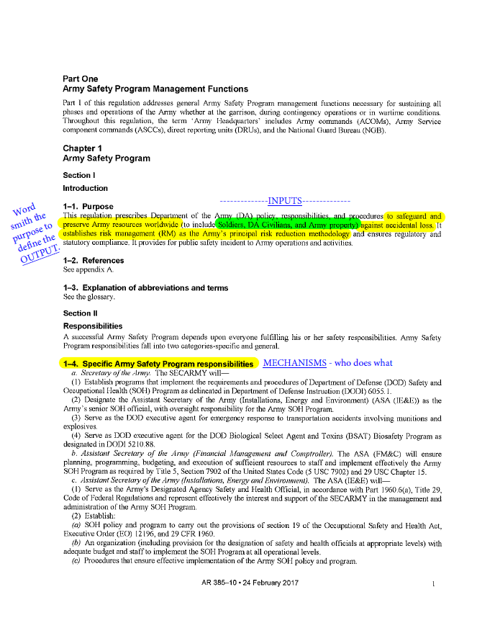
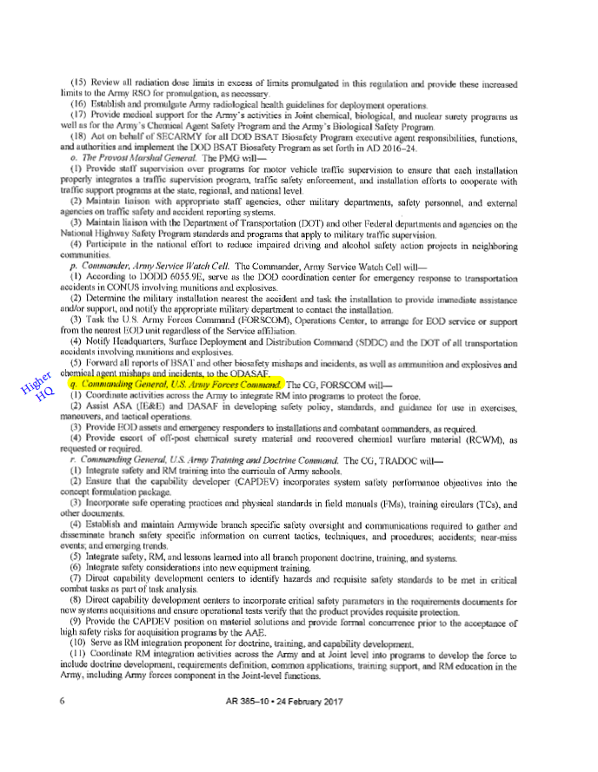
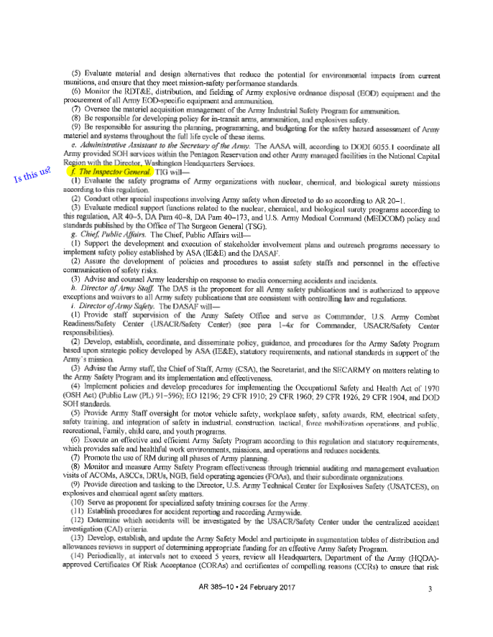

Slide 87
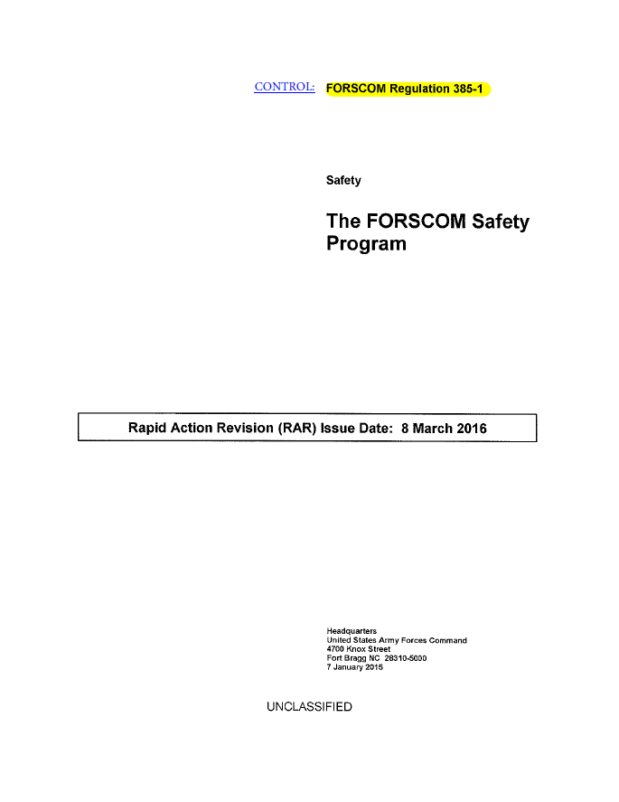
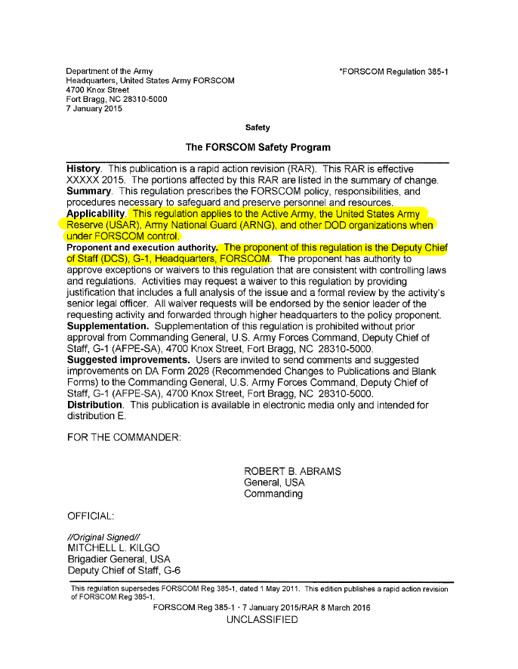
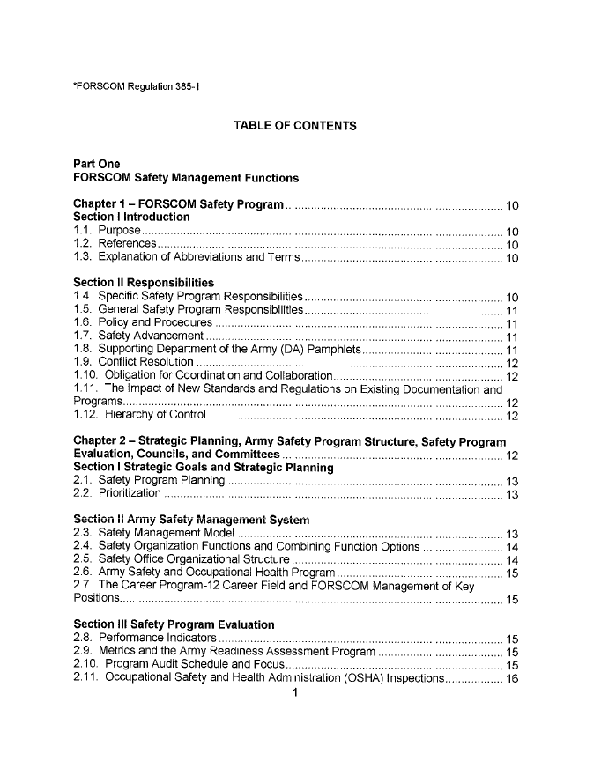
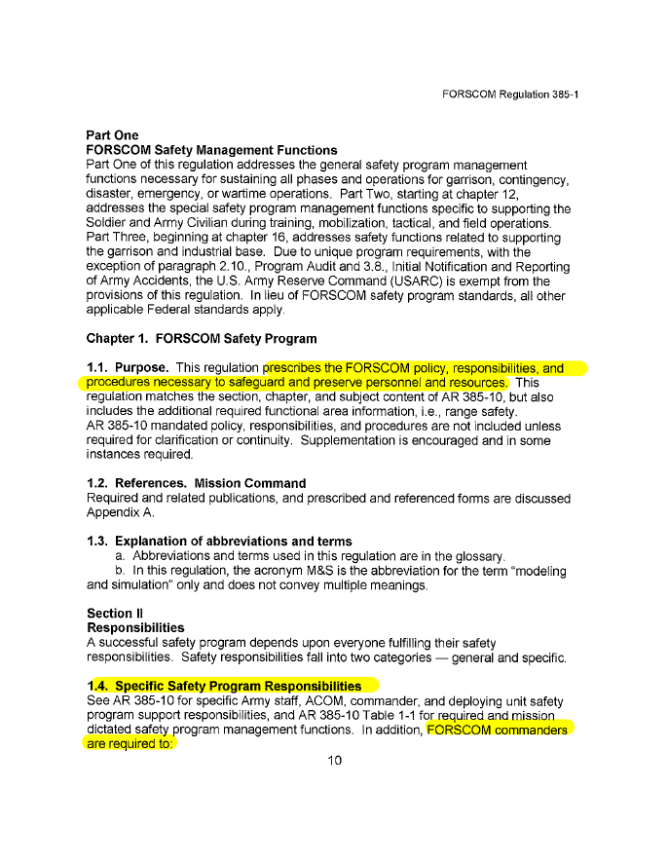
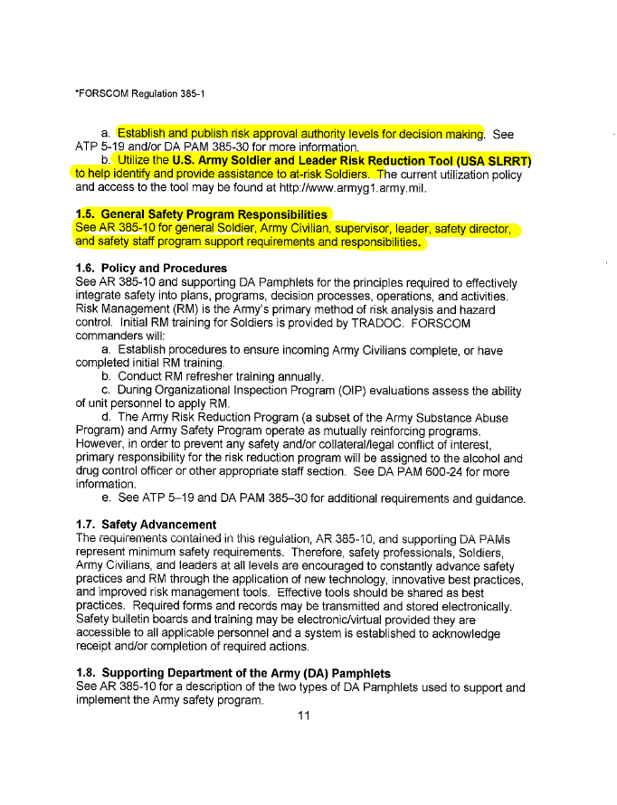

Slide 88
Example Functional Model #2
Let’s Break it Down
Inputs (i.e., ingredients to be transformed):
Army Resources (Soldiers, DA Civilians, and property)
Snazzy Crust =
Soldiers
Extra Cheese =
Property
Pepperoni =
DA Civilians

Slide 89
Example Functional Model #2
Soldiers
DA Civilians
Audits
Mechanisms:
Who:
What:
Soldiers / Civilians
Responsible for accident prevention by applying RM; employ RM in managing risk.
Supervisors & Operators
Responsible for RM during planning, preparation, and execution of all operations.
Army Leaders
Integrate RM, as described in DA PAM 385-30, into mission activities to prevent the accidental loss of personnel, facilities, weapons systems, and equipment during peacetime and wartime.
Commanders
Establish & publish risk-approval authority levels for decision-making.

Slide 90
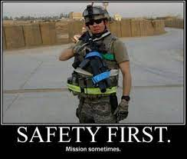
Example Functional Model #2
Output (i.e., ingredients are successfully transformed):
Army resources (to include Soldiers, DA Civilians, and Army property) are safeguarded and preserved worldwide by using risk management as the Army’s principal risk- reduction methodology.

Slide 91
Example Functional Model #2
System / Program / Function:
Composite Risk Management
Controls:
AR 385-10, Army Safety Program, (DAS)
FORSCOM REG 385-1 (G-1, ACOM)
Local Policy / Guidance (Senior Mission CDR)
Inputs:
Soldiers, DA Civilians, and Army property
Mechanisms:
Who:
What:
Soldiers / Civilians
Responsible for accident prevention by applying RM; employ RM in managing risk.
Supervisors & Operators
Responsible for RM during planning, preparation, and execution of all operations.
Army Leaders
Integrate RM, as described in DA PAM 385-30, into mission activities to prevent the accidental loss of personnel, facilities, weapons systems, and equipment during peacetime and wartime.
FORSCOM Commanders
Establish & publish risk-approval authority levels for decision-making.
Outputs:
Army resources (to include Soldiers, DA Civilians, and Army property) are safeguarded and preserved worldwide by using risk management as the Army’s principal risk- reduction methodology.

Slide 92
Example Functional Model #2
System / Program / Function:
Risk Management
** Consider working the functional model in this order:
Controls
Output
Inputs
Mechanisms
Controls:
Laws, regulations, policies, etc., that govern the process -- include proponent
Inputs:
People, systems, facilities, or equipment to be transformed during the process
Mechanisms:
Specific activities necessary to perform the process
(i.e., transform the inputs into the output)
Who What
Output:
Desired result of the system / program / process

Slide 93
Research
Use the information from your research to refine the purpose and narrow the scope of the inspection
The physical outputs of this step are the Inspection Purpose and the Inspection Objectives
The Inspection Purpose is a clear statement of the inspection’s over-arching goal
The Inspection Objectives are the most important aspect of the inspection plan because they will drive information-gathering
  An inspection objective should be clear, concise, and capture the essence of what the inspection team wants to learn
  Develop at least three objectives but no more than five

Slide 94
Research
Develop Objectives
System / Program / Function:
Baking a Mod Pizza
Where does the system seem to be ‘clogging up’?
Those possible ‘clogs’ help focus the objectives.
Controls:
TM 1-P Wood Fired Pizza Ovens ((Headquarters Mod Pizza (HQMP), P-3)
The Book of Top-Secret Pizza Recipes (HQMP, P-4)
Mod Pizza Employee Handbook (HQMP, P-1)
Inputs:
Snazzy crust, secret sauce, cheese, toppings
Mechanisms:
Who:
What:
Manager
Responsible for inventory management and supplier coordination / ordering; budget / accounting; safety and hygiene; communication; problem-solving; staff training;
Head Pizza Chef
Responsible for managing other cooks; advise Manager on ingredient quality vs profitability; equipment calibration and maintenance
Pizza Cooks
Responsible for following Head Chef’s guidance; following recipes; ingredient preparation (e.g., toss dough, assemble pizza, cook, etc.)
Outputs:
Ooey, gooey, hot (but not burnt) wood fired pizza

Slide 95
Research
Develop Objectives
Sample inspection objectives:
Determine if pizza cooks are preparing ingredients IAW TM 1-P, Wood Fired Pizza Ovens, Top-Secret Pizza Recipes, and the Mod Pizza Employee Handbook.
OR
Assess the company’s ingredient preparation process to determine its effectiveness IAW TM 1-P, Wood Fired Pizza Ovens, Top-Secret Pizza Recipes, and the Mod Pizza Employee Handbook.

Slide 96
Research
Develop Objectives
Sample inspection objectives:
Determine the effectiveness of the division's Sexual Harassment / Assault Response & Prevention (SHARP) training program in accordance with AR 350-1, Army Training and Leader Development.
OR
Determine if units within the division are conducting Sexual Harassment / Assault Response & Prevention (SHARP) training in accordance with AR 350-1, Army Training and Leader Development.

Slide 97
The Inspections Process
Phase One: The Preparation Phase
RESEARCH
DEVELOP CONCEPT
PLAN IN DETAIL
TRAIN UP
1
2
CDR
4
5
APPROVES CONCEPT
3
PRE-INSPECTION VISITS
6
The Inspections Guide (Sect 4-2, pages 4-2-8 to 4-2-10)

Slide 98
Develop the Concept
The concept is the blueprint for your inspection and forms the basis of your concept-approval briefing
The concept is a general plan that outlines how the inspection team plans to accomplish the inspection
The physical output of this step is a memorandum or a slide briefing (or both)

Slide 99
Develop the Concept
The inspection concept must have – at a minimum – the following items:
Inspection Purpose (from the Research step)
Inspection Objectives (from the Research step)
Scope of the Inspection (describes the unit types and sampling size; the team’s organization, number of IGs / augmentees / SMEs)
Focus (a “general” or “special” inspection)
Timing of Feedback (explains when the commander can expect to receive feedback on the inspection)
Timeline (outlines the key milestone dates)
Notification (explains how the team plans to notify the inspected units – announced or unannounced (not recommended))

Slide 100
The Inspections Process
Phase One: The Preparation Phase
RESEARCH
DEVELOP CONCEPT
PLAN IN DETAIL
TRAIN UP
1
2
CDR
4
5
APPROVES CONCEPT
3
PRE-INSPECTION VISITS
6
The Inspections Guide (Sect 4-2, pages 4-2-11 to 4-2-17)

Slide 101
The Commander Approves
the Concept
Schedule a time to brief your commander to gain approval
Prepare the Concept Briefing (decisional) from your Concept Memo and the Inspection Directive (for signature immediately following the briefing) as the physical outputs for this step
The Inspection Directive is a one-page document with:
  A statement directing the IG to conduct the inspection
  A list of all inspection objectives
  A statement outlining the tasking authority for all active, Reserve, National Guard, and tenant organizations
  A statement authorizing access to all required Army activities, organizations, and information sources to conduct the inspection

Slide 102
The Inspections Process
Phase One: The Preparation Phase
RESEARCH
DEVELOP CONCEPT
PLAN IN DETAIL
TRAIN UP
1
2
CDR
4
5
APPROVES CONCEPT
3
PRE-INSPECTION VISITS
6
The Inspections Guide (Sect 4-2, pages 4-2-18 to 4-2-36)

Slide 103
Plan in Detail
Planning the details of your inspection is critical during the Preparation Phase
The physical outputs of this step:
  Sub-Tasks (for the Objectives)
  Methodology
  Notification Letter (includes the Warning Order)
  Detailed Inspection Plan **(most important physical output)

Slide 104
Plan in Detail
Developing Sub-Tasks
Sub-Tasks focus the team’s approach to information-gathering and answering the objective(s)
Developing Sub-Tasks requires a great deal of thought and relies greatly upon the Research step:
  Subject-matter experts
  Applicable standards, policies, and regulations
Sub-Tasks form the basis for the findings statements the team will generate for the final report

Slide 105
Plan in Detail
Information-Gathering Domains
The IG’s Sources of Information
ELO
10
Interviews with key leaders or personnel
Sensing Sessions with officers, NCOs, and enlisted Soldiers
Document Review of pertinent documents (e.g., SOPs, policy letters, post regulations, training-guidance memorandums, etc.)
Observation of activities and exercises (e.g., Live Fire Exercises, Field Training Exercises, Military Decision Making Process exercises, after-action reviews, inspections, etc.)
Surveys and Questionnaires (normally used for Special-Interest Items that only require a sampling of a unit’s population)

Slide 106
Plan in Detail
Developing Sub-Tasks: Example
Objective 2: Determine if leaders at all levels understand, and can implement, the division’s Force Protection plan.
Sub-tasks:
2.1 Interview BDE / BN Commanders to determine if they understand the requirements and intent of the division’s Force Protection plan.
2.2 Conduct sensing sessions with company grade officers, NCOs, and enlisted Soldiers to determine if they understand – and are able to – implement the division’s Force Protection plan.
2.3 Review unit Force Protection SOPs and policies to determine if these documents adhere to the requirements of the division Force Protection plan.
2.4 Observe training, drills, and operations (as available) to determine if units are complying with division’s Force Protection plan.

Slide 107
Plan in Detail
Developing a Methodology
A methodology is the inspection team’s plan for physically conducting an inspection at a unit or staff agency.
The sub-tasks you developed for your objectives will drive your methodology.
The physical outputs of developing a methodology are as follows:
  Task Organization of the Inspection Team (includes augmentees)
  Baseline Methodology
  Sample Inspection Itinerary

Slide 108
Plan in Detail
Task Organization of the Inspection Team
Team A Team B
MAJ List (Infantry)* CPT Numero (Signal)
MSG Smith (Supply) SFC Bergerac (Maintenance)
Maintenance (G-4) Supply (G-4)
Personnel (G-1) Personnel (G-1)
Security (G-2) Security (G-2)
*MAJ List is the overall leader of the inspection effort.

Slide 109
Plan in Detail
Baseline Methodology
The Baseline Methodology is the standard approach the inspection team (or teams) will follow during a unit visit
The Baseline Methodology will include information-gathering assignments for each team member (i.e., interviewer, sensing-session facilitator, document reviewer, and observer)
The Baseline Methodology should also indicate how long an inspection team will spend at a unit or staff agency.
Division or Tenant Unit: One Day
  Staff Agency or Directorate: Half Day

Slide 110
Plan in Detail
Example Baseline Methodology:
  Personnel to interview (interviews and sensing sessions):
    Brigade and Battalion Commanders / CSMs / OIP Coordinator (MAJ List / CPT Numero – Interviewers)
    Directorate heads / Primary Staff Members (MAJ List / CPT Numero – Interviewers)
    Company Commanders and First Sergeants (MSG Smith / SFC Bergerac – Sensing Session)
    Senior NCOs within the staff agencies (MSG Smith / SFC Bergerac – Sensing Session)

Slide 111
Plan in Detail
Example Baseline Methodology:
  Documents to Review (on site or in advance):
    Division, Brigade, and Battalion OIP documents (MAJ List / CPT Numero)
    OIP results for the past two years (MSG Smith / SFC Bergerac / G-1 / G-2 / G-4)
    Unit SOPs relating to OIP (MSG Smith / SFC Bergerac / G-1 / G-2 / G-4)
    Training schedules to check OIP scheduling (MSG Smith / SFC Bergerac)
    Training Guidance or Command Philosophy memos with OIP guidance (MAJ List / CPT Numero)
  Events to Observe
    Observe scheduled inspections as available (All members)

Slide 112
Plan in Detail
Sample Inspection Itinerary
The Sample Inspection Itinerary allows the team to apply time constraints to the information-gathering requirements:
  0800-0815: Conduct In-Briefing with commander and staff (All members)
  0830-0930: Interview unit commander (MAJ List / G-2)
  0830-1000: Sensing Session with Company Commanders and First Sergeants (MSG Smith / G-1)
  0930-1030: Interview unit OIP Coordinator (MAJ List / G-2)
  1000-1130: Review documents (MSG Smith / G-1 / G-4)
  1300-1400: Interview Primary Staff Member (MAJ List / G-2)
  1300-1430: Sensing Session with senior staff NCOs (MSG Smith / G-1)
  1400-1530: Observe Staff Inspection of unit S-4 (MAJ List / G-4)
  1530-1630: IG Team IPR / Out-Briefing Preparation (All team members)
  1645-1715: Out-Briefing (All team members)

Slide 113
Plan in Detail
Notification Memorandum
The Notification Memorandum (or letter) officially notifies the unit or staff agency that an inspection is forthcoming
To draft this memo, the Inspection Team must choose the units and staff agencies that the team (or teams) will visit
A signed copy of the Notification Memorandum should go to all affected units and staff agencies at least six weeks before the first unit visit
A telephonic Warning Order normally precedes the Notification Memorandum by at least one week

Slide 114
Plan in Detail
Contents of the Notification Memorandum
The Notification Memorandum should include the following:
  Background information about the inspection
  Purpose of the inspection
  List of the units that the IG team (or teams) will visit
  The Inspection Objectives
  The Baseline Methodology for the inspection
  Feedback requirements
  Basic timeline
  Copy of the signed Inspection Directive as an enclosure

Slide 115
Plan in Detail
Detailed Inspection Plan
The Detailed Inspection Plan (DIP) is the single most important planning document the inspection team will produce
The DIP requires the greatest amount of detail possible so that – once issued – the document anticipates and answers the questions of all affected units and staff agencies
A good, solid DIP (Operations Order) will answer most of the inspected unit or staff agency’s questions

Slide 116
Plan in Detail
Contents of the Detailed Inspection Plan
At a minimum, the DIP should include:
  Directive
  Inspection Purpose
  Inspection Objectives
  Task Organization
  Inspection Locations + Dates
  Inspection Approach
  Interview Requirements
  Special Items of Interest
  Inspection Itineraries
  Document Requests
  Resources
  Administrative Support
  Requirements
  Report Completion Timeline
  Suspense Summary
  Distribution

Slide 117
The Inspections Process
Phase One: The Preparation Phase
RESEARCH
DEVELOP CONCEPT
PLAN IN DETAIL
TRAIN UP
1
2
CDR
4
5
APPROVES CONCEPT
3
PRE-INSPECTION VISITS
6
The Inspections Guide (Sect 4-2, pages 4-2-37 to 4-2-44)

Slide 118
Train Up
The Inspection Team’s Time
  Arrange for SMEs to teach classes to inspection team members
  Incorporate augmentee personnel into the team and assign them specific duties and responsibilities
  To become Temporary Assistant IGs, augmentees must be:
    Trained on the tenet of confidentiality, nature of IG records, and IG System Concept
    Administered the IG oath
  Develop your information-gathering tools (e.g., interview and sensing-session questions, observation spot reports, etc.)
  Rehearse your interviews, sensing sessions, and other portions of the planned methodology that you may need to “shake out”

Slide 119
Train Up
Developing Information-Gathering Tools
  The Information-Gathering tools you develop must focus on your objectives and how to answer them
  Information-Gathering tools include:
    Interview Questions
    Sensing-Session Questions
    Observation Spot-Report Formats
    Guidelines for Document Reviews
    Surveys or Questionnaires

Slide 120
Train Up
Developing Information-Gathering Tools
  Guidelines for developing questions:
    Focus on answering the requirements of the Sub-Tasks
    Open-ended questions encourage discussion – consider the TED method:
      “Tell me…”
      “Explain…”
      “Describe…”
    Develop questions that get to the root cause of non-compliance
    Tailor questions to fit the person (or people) you will interview or sense

Slide 121
The Inspections Process
Phase One: The Preparation Phase
RESEARCH
DEVELOP CONCEPT
PLAN IN DETAIL
TRAIN UP
1
2
CDR
4
5
APPROVES CONCEPT
3
PRE-INSPECTION VISITS
6
The Inspections Guide (Sect 4-2, pages 4-2-37 to 4-2-44)

Slide 122
Pre-Inspection Visits
  Pre-Inspection Visits are necessary to validate and refine your inspection methodology and information-gathering tools
  The inspection team should conduct a Pre-Inspection Visit for each type of unit or agency they will visit
  Conduct the Pre-Inspection Visit exactly as outlined in the DIP
  Do not use the information gleaned from this visit in the inspection report

Slide 123
The Inspections Process
Phase One: The Preparation Phase
RESEARCH
DEVELOP CONCEPT
PLAN IN DETAIL
TRAIN UP
1
2
CDR
4
5
Purpose
Objectives
Concept Memo
Info-gathering Tools
Rehearsals
APPROVES CONCEPT
3
Sub-Tasks
Methodology
  Task Organization
  Baseline Methodology
  Sample Itinerary
Notification letter
Detailed Inspection Plan
PRE-INSPECTION VISITS
Concept Briefing
Inspection Directive
6
The Inspections Guide (Sect 4-2)

Slide 124
The Inspections Process
Phase Two: The Execution Phase
IPR
8
ANALYZE RESULTS
VISIT
UNITS
OUT-BRIEF PROPONENT
CROSSWALK
7
10
11
UPDATE CDR
9
The Inspections Guide (Sect 4-3)

Slide 125
VISIT UNITS
The Inspections Process
Phase Two: The Execution Phase
IPR
8
ANALYZE RESULTS
VISIT
OUT-BRIEF PROPONENT
UNITS
CROSSWALK
7
10
11
UPDATE CDR
9
The Inspections Guide (Sect 4-3, pages 4-3-2 to 4-3-7)

Slide 126
Visit Units
Be open and discreet!
  Execute your methodology and itinerary
  Conduct an in-briefing to inform unit or staff agency leaders of the inspection purpose and scope
  Conduct interviews, sensing sessions, document reviews, and observation using your information-gathering tools
  Provide a written or verbal out-briefing to inspected commanders, staff, and/or proponents (focus on general IG findings and not sources)
    Avoid attribution when sharing your observations (attribution of good news is authorized IAW AR 20-1, para 5-1 j & k)
    You may leave a hard-copy version of the out-brief with the command

Slide 127

Visit Units
Write the Trip Report
  Immediately following an inspection visit to a unit or staff agency, the team members must compile their information into a Trip Report
  Trip Reports are…
    the primary-source documents for writing the Final Report
    memorandums that allow team members to capture the information they just gathered
    a permanent IG record of the inspection visit
    Trip reports prevent the Inspection Team from losing important data that team members can easily forget

Slide 128
Visit Units
Writing a Trip-Report Observation
Each observation should include some (or all) of the following:
  Raw-data – Unprocessed examples of what you saw, read, or heard.
  Synthesized information – Sentences that combine raw-data to summarize the information
  Analyzed information – Sentences that critically examine and process raw-data to glean greater meaning from the information
  Inspector’s Opinion – The observer’s sense or impression of an event or people interviewed

Slide 129
The Inspections Process
Phase Two: The Execution Phase
IPR
ANALYZE RESULTS
VISIT
8
OUT-BRIEF PROPONENT
UNITS
CROSSWALK
7
10
11
UPDATE COMMANDER
9
The Inspections Guide (Sect 4-3, pages 4-3-8 to 4-3-19)

Slide 130
Conduct an
In-Process Review (IPR)
ELO
1
  The purpose of the IPR is to share and discuss the information that team members gleaned from their visits to units and staff agencies
  Conduct an IPR following every inspection visit and after several visits
  Conduct the IPR as an organized, well-prepared meeting that has an agenda and a means of collecting the data for open consideration by all team members
    Sample IPR Worksheet
    Sample Trends Analysis Sheet

Slide 131
Conduct an
In-Process Review (IPR)
Sample Agenda
  Review Administrative Issues
  Calendar Updates and Changes
  Complete the IPR Worksheet by:
    objective,
    team (or team member), AND
    information-gathering domain
  Physical output: Completed Trends Analysis or a Unit Out-Briefing
  Final Comments and guidance by the person in charge of the inspection

Slide 132
UPDATE COMMANDER
The Inspections Process
Phase Two: The Execution Phase
IPR
ANALYZE RESULTS
VISIT
8
OUT-BRIEF PROPONENT
UNITS
CROSSWALK
7
10
11
UPDATE COMMANDER
9
The Inspections Guide (Sect 4-3, page 4-3-20)

Slide 133
Update the Commander
  Your commander may request an in-progress update of the inspection
  In most cases, you will develop an information with the current trends you are finding
  Refer to the most up-to-date version of your Trends Analysis Sheet for what information to include in the briefing
  Review the concept and inspection schedule with your commander as part of the briefing

Slide 134
UPDATE COMMANDER
The Inspections Process
Phase Two: The Execution Phase
IPR
8
ANALYZE RESULTS
VISIT
OUT-BRIEF PROPONENT
UNITS
7
CROSSWALK
10
11
UPDATE COMMANDER
9
The Inspections Guide (Sect 4-3, pages 4-3-21 to 4-3-33)

Slide 135
Analyze the Results
and Cross-walk
Write the Final Report
  Analyzing the results means you must now organize the inspection team to begin writing the Final Report
  Develop a game plan that assigns writing responsibilities to the team members
  Develop a Final Report format, to include a standard format for each of the major chapters
  Set a Final Report timeline that gives your team members enough time to analyze and write their findings and conduct cross-walking, as necessary

Slide 136
Analyze the Results
and Cross-walk
What is Cross-Walking?
ELO
1
  Cross-walking is the process of following up on certain inspection results that might require further verification
  The purpose is to verify – or validate – the accuracy of what you saw, read, or heard
  Cross-walking may take you vertically (up the chain) or horizontally (across command lines).
  IGs frequently define cross-walking as the “dogged pursuit of the truth”
  In most cases, cross-walking is nothing more than a phone call to someone who might clarify a particular issue or verify what you saw or were told is in fact accurate

Slide 137
Analyze the Results
and Cross-walk
Structuring the Final Report
  The Final Report should follow a basic format:
      Table of Contents
      Guidance on the Release of IG Information
      Executive Summary
      Chapters on Background and Methodology
      Chapter for each Objective (with findings by Sub-Task)
      Summary of Recommendations
      Appendices:
        References
        Inspection Directive
        Units Visited
        Interview and Sensing-Session Questions

Slide 138
Analyze the Results
and Cross-walk
How do you write a chapter for an Objective?
  The process of writing each Objective chapter will result in the findings for that objective
  Each objective will have at least one finding statement per Sub-Task
  Each Sub-Task will have no less than one findings section and some Sub-Tasks may have two, or even three, finding statements / findings sections
  The Team Leader must oversee the process from start to finish and serve as the final editor of the report

Slide 139
Analyze the Results
and Crosswalk
A Chapter-Writing Method that Works
Organize your team so that IGs and augmentees are involved in either the writing or reviewing process
The Team Leader should organize the team as follows:
  Overseer of the Process (Team Leader)
  Writers for each Objective Chapter (IG members)
  Chapter-Review Committee (Team Leader with one or more of the augmentees)
  Writer of the Methodology and Background Chapters (Team Deputy)
  Writer of the Executive Summary, Summary of Recommendations, and remaining sections (Team Leader)
  Final Editor and Reviewer (Team Leader)

Slide 140
Analyze the Results
and Crosswalk
Writing a Chapter for an Objective
Step 1: Gather the Tools
Step 2: Develop a Writing Schedule
Step 3: Organize Your Sources
Step 4: Review and Study Your Sources
Step 5: Develop Tools to Collect and Analyze Your Information
Step 6: Develop Your Findings Statements
Step 7: Write Your Findings Sections
Step 8: Complete the Chapter
Step 9: Submit the Draft Chapter for Committee Review (“Murder Board”)

Slide 141
Step 1: Gather the Tools
Print copies of all the Trip Reports
Craft a word-processing template of the chapter you will write using the established format
Ensure that you have copies on hand of the key references pertaining to your inspection PLUS The Inspections Guide
Gather different-colored highlighters so you can color-code the information in the Trip Reports (consider color-coding by sub-task)

Slide 142
Step 2: Develop a Writing Schedule
Create a calendar plan identifying the specific days you will work on a particular Sub-Task or portion of the chapter
Tailor the schedule to your own abilities. Don’t get too ambitious. Be realistic!
Review the writing schedule to ensure it meets the overall report-writing timeline and allows you enough time to review your draft
Stick to this writing schedule!

Slide 143
Step 3: Organize Your Sources
Write bold headings at the top of each Trip Report in a colored pen or marker to quickly distinguish one from the others
Remember: You will be juggling several different Trip Reports as you write your chapter
Place the Trip Reports in folders or develop another system to ensure ease of access and organization

Slide 144
Step 4: Review and Study Your Sources
Go through each Trip Report and use the different colored highlighters to identify the information pertaining to each Sub-Task (i.e., color-code the data by Sub-Task)
Once you have highlighted the information, go back and read – in a leisurely fashion – all of the information pertaining to the first Sub-Task about which you plan to write
Absorb and try to understand the varying types of information without attempting to analyze or categorize the information. Let your mind wander freely!
Mentally formulate your findings based on what the highlighted information tells you

Slide 145
Step 5: Develop Tools to Collect and Analyze Your Information
After absorbing the information you have just read, develop a tool / matrix to help you organize your thoughts and the information you gathered
Use the Trends Analysis Sheet or a similar matrix to identify and lay out the common bits of information from the Trip Reports
Do not allow yourself to become bogged down by smaller bits of information. Stay focused on the bigger picture!
Conduct cross-walking as necessary. Call those individuals whom you think can help.

Slide 146
Step 6: Develop Your Finding Statement(s)
The finding statement is a single, well-focused, well-structured sentence that captures the true essence of the finding. This sentence must be able to stand alone. For example:
  Most active-duty battalions are not conducting Initial Command Inspections within 90 days of the commander assuming command in accordance with AR 1-201.
You will base your finding statement(s) on the preponderance of information you gather about a particular Sub-Task. For example:
  If 65 percent of the data we collected leans toward an Army-wide finding that Risk Management is not getting into the updated doctrinal manuals, then your finding will state that fact. You can address the other 35 percent who are having success when you write the discussion (i.e., Inspection Results portion) for that finding.

Slide 147
Step 7: Write Your Findings Sections
ELO
11
Finding Section Format –
(1) Finding Statement
    (2) Standard
    (3) Inspection Results
    (4) Root Cause
    (5) Recommendation(s)
The Inspections Guide (Sect 4-3, pages 4-3-24 to 4-3-25)

Slide 148
Step 7: Write Your Findings Sections
  (1) Finding Statement: Be certain to include positive findings and not just negative findings.
  (2) Standard: Write the entire standard for that finding verbatim (i.e., word for word) from the original source. Do not paraphrase the text and omit nothing. Remember: A particular standard may not exist for your finding; therefore, simply use this paragraph to discuss the context for your finding.
  (3) Inspection Results: Write the Inspection Results section to address each and every point that you must make to support your findings statement. This section is possibly the most critical portion of your findings section. You must explain the nature of your finding and any other significant items that pertain directly to that finding. Individuals or staff agencies who will be acting on the recommendations will rely on this section heavily to identify and fix the problem.
  (4) Root Cause: Follow the Root-Cause Analysis model. Remember: A positive finding normally will not have a root cause.
  (5) Recommendation(s): Ensure that your recommendation identifies the person or staff agency that can fix the problem.

Slide 149
Step 8: Complete the Chapter
Compile all of the Findings Sections into one document using the established chapter format
Read and re-read the chapter several times to ensure consistency and avoid needless redundancy
Read the chapter out loud to yourself to help eliminate grammar errors or extraordinarily long sentences

Slide 150
Step 9: Submit the Chapter for Peer and Committee Review
Let someone else read your draft chapter and point out any obvious errors or inconsistencies
Make any necessary adjustments to the draft and then print clean copies for your Team Leader and Committee (Reviews)
The Team Leader will arrange a time for you to meet with the committee to answer questions or address problem areas – a “murder board.”
Make any necessary changes to the document and submit a clean copy to the Team Leader for a final grammar and format review

Slide 151
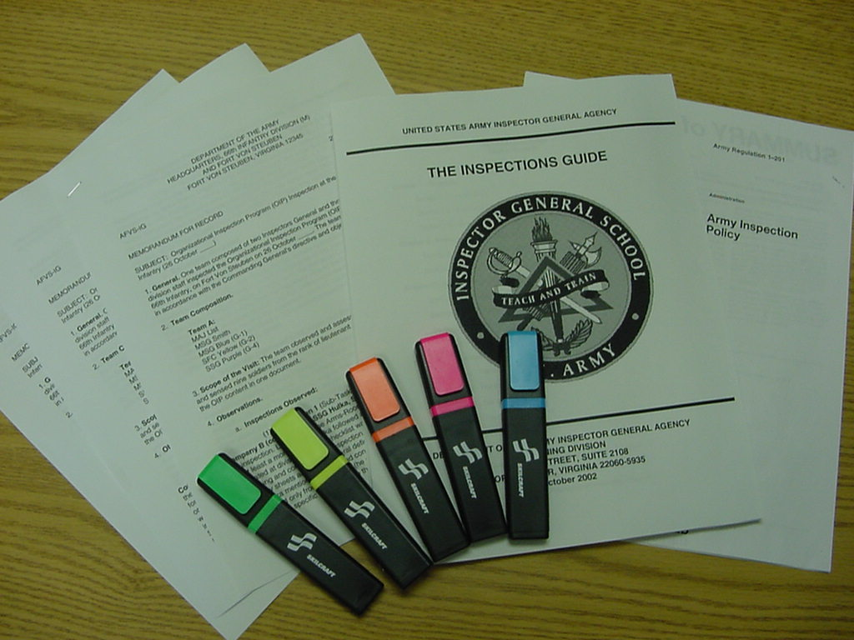
Let’s Practice:
Step 1: Gather the Tools

Slide 152
Step 2: Develop a Writing Schedule
For example:
  12-14 November: Write Sub-Task 3.1
  15-17 November: Write Sub-Task 3.2
  18-20 November: Write Sub-Task 3.3
  21-23 November: Write Sub-Task 3.4
  28-29 November: Finish Chapter

Slide 153
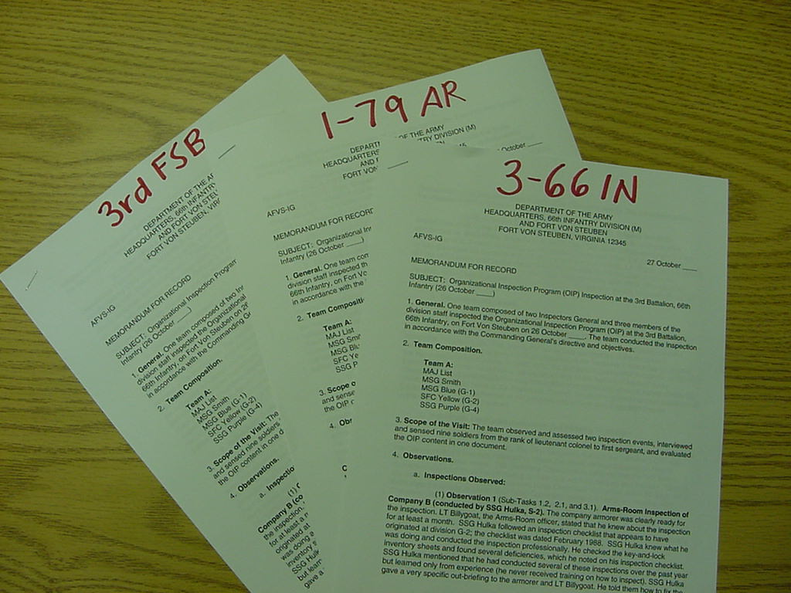
Step 3: Organize Your Sources
1-79 AR
1-66 AV
4-66 IN

Slide 154
Step 4: Review and
Study Your Sources
Go through each Trip Report using different colored markers to highlight the information for pertaining to your Sub-Tasks. Use a different color for each Sub-Task.
Once you have highlighted the information, go back and read – in a leisurely fashion – all of the information pertaining to the first Sub-Task about which you will plan to write.
Absorb and try to understand the varying types of information without attempting to analyze or categorize the information. Let your mind wander freely!

Slide 155
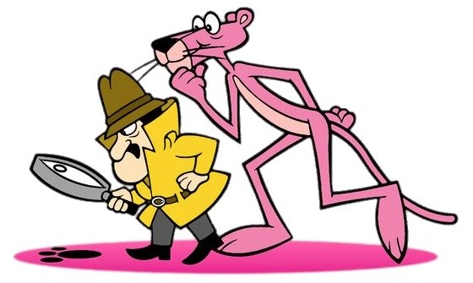
Example:
Sub-Task 3.2
Determine if active-duty battalion-level units are conducting Initial Command Inspections in accordance with AR 1-201.

Slide 156
4-66 Infantry Trip Report
(1) Observation 1 (Sub-Tasks 1.1, 1.3, and 3.2). Company Commander and First Sergeants Sensing Session. The First Sergeants felt that the battalion's OIP was executed carelessly and was intended to "check the block" without focusing on how to improve the inspected areas. The Company Commanders believed that the OIP was a distraction and kept them from focusing on their real wartime mission and training. None of the commanders present received an Initial Command Inspection within 90 days of assumption of command. All of them stated that they received their Initial Command Inspection well after 90 days of assuming command. The Company Commanders felt that these initial inspections were good but that no one ever followed up on the results to check for improvement. The First Sergeants said that these inspections were nothing more than a 'paper drill.' None of the Company Commanders had ever seen a written battalion OIP program. No written OIP programs existed at the company level.

Slide 157
4-66 Infantry Trip Report
(2) Observation 2 (Sub-Tasks 1.1, 1.3, 2.1, and 3.2). Interview with the Battalion Commander (LTC Johnson). LTC Johnson has been in command for 13 months. He admitted that he did not have a written OIP “as far as he knew.” He allows the XO to handle the OIP and conduct the program "the way the unit did it in the past." He has never seen a written brigade OIP but stated that the Brigade XO normally discusses OIP-related topics at the brigade staff calls. He was not aware of the division OIP memorandum and had never heard of AR 1-201. The battalion recently conducted some Staff-Assistance Visits to the companies in preparation for the Brigade Command Inspection in January, but some Company Commanders complained that the inspectors were too inexperienced or untrained. Initial Command Inspections for the companies normally occur several months after the command assumes command, but never within 90 days. LTC Johnson feels comfortable that the brigade is scheduling Command Inspections well in advance. He is not aware of any inspector-training programs within his battalion.

Slide 158
HHC, 2nd BDE Support BN Trip Report
(2) Observation 2 (Sub-Tasks 1.1, 3.1, and 3.2): Interview with the Company Commander (CPT Black). CPT Black stated that she had received at least four inspections during her 19 months in command. She stated that members of the division staff inspected her and conducted each inspection professionally. She appreciated the detailed feedback that she received at each out-briefing. CPT Black said that she had received her Initial Command Inspection during her first month of command and that a Subsequent Command Inspection followed six months later. CPT Black did not feel that the inspections were a burden, but she wished that the Brigade S-3 would ensure that her company’s inspections ended up on the Brigade Short-Range Calendar. The current calendar does not have HHC scheduled for an inspection, but she learned last month that she could expect an inspection in December.

Slide 159
HHC, 2nd BDE Support BN Trip Report
(2) Observation 2 (Sub-Tasks 1.1, 3.1, and 3.2): Interview with the Company Commander (CPT Black). CPT Black stated that she had received at least four inspections during her 19 months in command. She stated that members of the division staff inspected her and conducted each inspection professionally. She appreciated the detailed feedback that she received at each out-briefing. CPT Black said that she had received her Initial Command Inspection during her first month of command and that a Subsequent Command Inspection followed six months later. CPT Black did not feel that the inspections were a burden, but she wished that the Brigade S-3 would ensure that her company’s inspections ended up on the Brigade Short-Range Calendar. The current calendar does not have HHC scheduled for an inspection, but she learned last month that she could expect an inspection in December.

Slide 160
1-66 Aviation Trip Report
(7) Observation 7 (Sub-Tasks 1.1, 1.3, and 3.2) Company Commander and First Sergeants Sensing Session. The Company Commanders felt that the constant number of inspections was cutting into their training and flying time. They thought that the inspections were “ridiculous and unfocused.” The battalion never spent a week inspecting one company at a time. Instead, the different staff sections inspected each company over a period of three or four months. The Battalion Commander was never involved. The First Sergeants agreed with their commanders’ assessments and stated that the Command Sergeant Major seemed to be the only one involved in the inspection process. Only one of the four commanders present had received an Initial Command Inspection during their first 90 days of command. The other commanders received their Initial Command Inspections after 90 days of assuming command.

Slide 161
Step 5: Develop Tools to Collect and Analyze Your Information
IPR Worksheet:
UNIT | Objective 3. Sub-Task 3.2
4-66 IN | -Battalion Commander says no ICIs under 90 days -Battalion Commander says ICIs usually done after 90 days of command -CDRs/1SGs say no ICIs during first 90 days of command -CDRs/1SGs say ICIs occur several months after taking command
HHC, 2nd BDE Support BN | -Company CDR says ICI during first month of command -ICIs occurred IAW AR 1-201
1-66 AV | -1 of 4 Company CDRs received ICI during first 90 days of command -3 of 4 Company CDRs received ICI after 90 days of command
Interviews Sensing Sessions

Slide 162
Step 5: Develop Tools to Collect and Analyze Your Information
Trend Analysis:
Trend | 4-66 IN | HHC, 2nd BDE Support BN | 1-66 AV
Battalions not conducting ICIs during first 90 days of command | Y | N | Y
ICIs occur after 90 days of command | Y | N | Y

Slide 163
Step 6: Develop Your Finding Statement(s)
Possible Finding Statements:
  Finding 1: Most active-duty battalions are not conducting Initial Command Inspections in accordance with AR 1-201.
  Finding 2: Most active-duty battalions are conducting Initial Command Inspections for companies but not within 90 days of assuming command as prescribed in AR 1-201.

Slide 164
Step 7: Write Your Findings Sections
ELO
11
Finding Statement: Write the finding statement as you developed it during Step 6.
Standard: Write out the standard word for word and omit nothing. Remember: A particular standard may not exist for your finding; therefore, simply use this paragraph to discuss the context for your finding.
Inspection Results: This section is possibly the most critical portion of your findings section. You must explain the nature of your finding and any other significant items that pertain directly to that finding. The individuals or staff agencies who will be acting on the recommendations will rely on this section heavily to identify and fix the problem.
The Inspections Guide (Sect 4-3, pages 4-3-28 to 4-3-30)

Slide 165
Step 7: Write Your Findings Sections
(1) Finding Statement 3.2: Most active-duty battalions are conducting Initial Command Inspections for companies but not within 90 days of assuming command as prescribed in AR 1-201.
(2) Standard: Army Regulation 1-201, Army Inspection Policy, outlines the requirement to conduct Initial Command Inspections within 90 days. In Paragraph 3-3, Command Inspections: “c. Initial command inspections. (1) A new company commander (or leader of a similarly-sized organization) will receive an ICI from his or her commander, who should also be that company commander’s rater. (2) The ICI for companies will occur within the first 90 days of assumption of command for the Regular Army and 180 days for the Reserve Component (USAR and ARNGUS). The 90-day standard applies to Reserve Component Units mobilized on active duty.”

Slide 166
Step 7: Write Your Findings Sections
(3) Inspection Results: The Inspection Team determined that all of the battalions inspected within the division are conducting Initial Command Inspections as required by AR 1-201. However, a majority of these battalions (66%) are failing to comply with the added requirement to perform these inspections within 90 days of an officer assuming command of an active-duty company. Some companies are receiving the inspections within 90 days (in one case within 45 days); however, most companies are receiving Initial Command Inspections after 90 days but within six months.
**Note: The Inspection Results portion is normally two to three paragraphs in length and should reflect why the problem is occurring. Since this example is for demonstration purposes, it contains only one brief discussion paragraph.

Slide 167
Step 7: Write Your Findings Sections
ELO
11
Reasons for Non-Compliance
DON’T KNOW
CAN’T COMPLY
WON’T COMPLY
1. NEVER KNEW
2. FORGOT
3. TASK IMPLIED
1. SCARCE RESOURCES
2. DON’T KNOW HOW
3. IMPOSSIBLE TO DO
1. NO REWARD
2. NO PENALTY
3. DISAGREE
** Follow the root cause analysis model outlined in The Inspections Guide. Remember, positive findings will not normally have a root cause.
The Inspections Guide (Sect 3-3, pages 3-3-1 to 3-3-3)

Slide 168
Step 7: Write Your Findings Sections
ELO
11
Root Cause: (Don’t Know) / (Can’t Comply) / (Won’t Comply) …
  Start with the root cause.
  Followed by 1-2 sentences explaining why.
Recommendation(s): This paragraph must identify clearly and concisely what the IG recommends that a particular individual or staff agency do to correct the problem.
  The paragraph will begin as follows: The IG recommends that …
  The recommendation must tag a specific individual or staff agency.

Slide 169
Step 7: Write Your Findings Sections
(4) Root Cause: (Don’t Know) Leaders at the battalion and company levels are unaware of the requirement to conduct Initial Command Inspections within 90-days of an officer assuming command. None of the leaders interviewed or sensed within these units mentioned any time or resource constraints that prevented the inspections from occurring within the prescribed time.
(5) Recommendation: The IG recommends that the Division IG Office, in close coordination with the G-3, host a division-wide Organizational Inspection Program workshop as soon as possible – and then annually thereafter – to teach Brigade and Battalion Commanders about the Army’s Inspection policy and the specific requirements for Initial Command Inspections.

Slide 170
Step 8: Complete the Chapter
Compile all of the Findings Sections into one document using the established chapter format.
Read and re-read the chapter several times to ensure consistency and to avoid needless redundancy.
Read the chapter out loud to yourself to help eliminate grammar errors or extraordinarily long sentences.

Slide 171
Step 9: Submit the Chapter for Peer and Committee Review
Draft Chapter
Committee
Review
START
Team Leader
Review
FINISH
Committee
Meeting
Editing
Revise
Chapter

Slide 172
Analyze the Results
and Crosswalk
What is the Final Result of this step?
  The final result of this step is a Draft Version of the Final Report
  This draft version will serve as the basis for your briefings to the proponents and to the commander
  Develop a slide presentation or some other means to facilitate the briefing

Slide 173
UPDATE COMMANDER
The Inspections Process
Phase Two: The Execution Phase
IPR
8
ANALYZE RESULTS
VISIT
OUT-BRIEF PROPONENT
UNITS
7
CROSSWALK
10
11
UPDATE COMMANDER
9
The Inspections Guide (Sect 4-3, pages 4-3-34 to 4-3-35)

Slide 174
Out-Brief the Proponent
Who is the proponent?
  The person or staff agency responsible for fixing the problem
  Each of your recommendations names a proponent
  Before you brief your final report to the commander, ensure you brief each affected proponent in advance as a courtesy
  The proponent may inform you that he or she is not the correct person – or staff agency – to fix the problem
  Be professional! Remember: The proponent does not have to agree with your findings or recommendations

Slide 175
UPDATE COMMANDER
The Inspections Process
Phase Two: The Execution Phase
IPR
8
ANALYZE RESULTS
Trends Analysis
Unit Out-Briefing
OUT-BRIEF PROPONENT
VISIT
UNITS
7
CROSSWALK
10
11
Trip Report
Draft Final Report
Inspection Results Briefing
UPDATE COMMANDER
9
Update Briefing
The Inspections Guide (Sect 4-3)

Slide 176
The Inspections Process
Phase Three: The Completion Phase
FINALIZE
REPORT
OUT-BRIEF COMMANDER
DISTRIBUTE REPORT
SCHEDULE FOLLOW UP
12
14
16
17
TASKERS
13
HANDOFF
15
The Inspections Guide (Sect 4-4, page 4-4-2)

Slide 177
The Inspections Process
Phase Three: The Completion Phase
FINALIZE
REPORT
OUT-BRIEF COMMANDER
DISTRIBUTE REPORT
SCHEDULE FOLLOW UP
12
14
16
17
TASKERS
13
HANDOFF
15
The Inspections Guide (Sect 4-4, page 4-4-2)

Slide 178

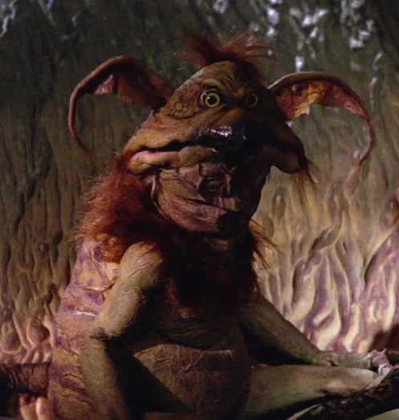
Out-Brief the Commander
  Develop a formal briefing to present the results of your inspection to the Commander
  You must know your findings well and be able to speak in support of them. You may be telling the Commander some bad news that he or she does not want to hear!
  Request Commander’s approval of the report following the briefing
“Sir / Ma’am, you’ve got an UGLY BABY!”
or

Slide 179
The Inspections Process
Phase Three: The Completion Phase
FINALIZE
REPORT
DISTRIBUTE REPORT
SCHEDULE FOLLOW UP
OUT-BRIEF COMMANDER
12
14
16
17
TASKERS
13
HANDOFF
15
The Inspections Guide (Sect 4-4, page 4-4-3)

Slide 180
Taskers
  The individuals or staff agencies you listed in your approved recommendations will receive taskers to initiate the actions required to fix the problems
  The IG’s role is to monitor the assignment of a tasker and to be aware of each tasker’s completion
  The IG is not a tasking authority. The Commander, Chief of Staff, or G-3 should handle the taskers
  Be prepared to work with the staff agencies or individuals tasked to help them solve the problem

Slide 181
The Inspections Process
Phase Three: The Completion Phase
FINALIZE
REPORT
OUT-BRIEF COMMANDER
FINALIZE REPORT
DISTRIBUTE REPORT
SCHEDULE FOLLOW UP
12
14
16
17
TASKERS
13
HANDOFF
15
The Inspections Guide (Sect 4-4, pages 4-4-4 to 4-4-6)

Slide 182
Finalize Report
  Revise or adjust the Final Report based upon the Commander’s guidance or feedback
  Develop a cover letter for the Commander’s signature that outlines his or her approval of the final report’s results. This cover letter will become the first page of the report.
  Submit a copy of the report to the Commander for review and for his or her signature on the cover letter
  Conduct a final edit to ensure accuracy and correctness
  Ensure that the report does not name names or mention units! Confidentiality is important!

Slide 183
The Inspections Process
Phase Three: The Completion Phase
FINALIZE
REPORT
OUT-BRIEF COMMANDER
DISTRIBUTE REPORT
SCHEDULE FOLLOW UP
12
14
16
17
TASKERS
13
HANDOFF
15
The Inspections Guide (Sect 4-4, page 4-4-7)

Slide 184
Handoff
ELO
1
  Handoff is the transferring of a verified finding to a higher-level agency or command that can correct the problem
  Occurs only when your CDR / staff cannot fix a problem at their level
  Can occur through IG Technical Channels or Command Channels – or both!
  If you handoff through IG channels, enter the finding into IGARS as an Assistance Case and refer the IGAR to the next higher IG office
  Handoffs through IG Technical Channels to DAIG go through the IG chain to the Analysis and Inspections Follow-up Office (SAIG-AI [AIFO]), IAW AR 20-1, paragraph 5-1h(3)
  Always monitor the progress of a handoff so that you can keep your Commander informed

Slide 185
Distribute the Report
Phase Three: The Completion Phase
FINALIZE
REPORT
DISTRIBUTE REPORT
OUT-BRIEF COMMANDER
SCHEDULE FOLLOW UP
12
14
16
17
TASKERS
13
HANDOFF
15
The Inspections Guide (Sect 4-4, page 4-4-8)

Slide 186
Distribute the Report
ELO
12
  Command IGs may release an inspection report to the Directing Authority, who in turn may release the approved report to other Army agencies and commands when an official need for the report is apparent
  The IG may distribute the inspection report to those units or staff proponents who will help improve the system, function, or program inspected or who may benefit from the report’s information
  Selected DAIG’s inspection reports are at (requires AKO access): https://armypubs.us.army.mil/publications/administrative/pog/TIG.aspx
  The Final Report must be properly marked
AR 20-1 (para 3-4)

Slide 187
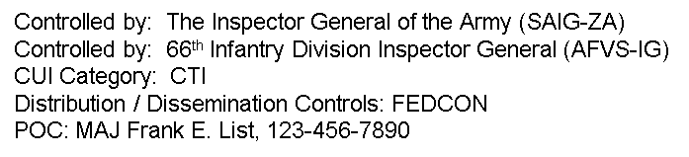
Marking the Report
  The Final Report must be properly marked as follows:
CUI
Top and bottom of each page must be marked with CUI Header and Footer in 16 font BOLD
Bottom right of front page marked as follows:
Controlled by: The Inspector General of the Army (SAIG-ZA)
Controlled by: 66th Infantry Division Inspector General (AFVS-IG)
CUI Category: CTI
Distribution / Dissemination Controls: FEDCON
POC: MAJ Frank E. List, 123-456-7890
CUI

Slide 188
Inspection Reports
ELO
12
AR 20-1 allows local IGs to release written inspection reports for official use after the commander approves the report as long as it meets the following criteria:
Free of unit or individual information
Will not be used for adverse action
Will not be used to compare commands / commanders
Contains appropriate markings
Inspection Reports
Otherwise, TIG is the
Release Authority for
the IG records
AR 20-1 (para 3-6)

Slide 189
The Inspections Process
Phase Three: The Completion Phase
FINALIZE
REPORT
SCHEDULE FOLLOW UP
OUT-BRIEF COMMANDER
DISTRIBUTE REPORT
12
14
16
17
TASKERS
13
HANDOFF
15
The Inspections Guide (Sect 4-4, page 4-4-9)

Slide 190
Schedule Follow-Up
  Follow-up is an important inspection principle that applies to all Army inspections
  An inspection is not complete if the inspecting agency does not follow-up to determine if the necessary corrective actions have occurred
  You can follow-up an inspection using four different methods:
    Follow-Up Inspection: This method is the most effective but is also the most resource intensive
    Follow-Up Visit: Visit the individuals or agencies responsible for the corrective action to determine their progress
    Telephone: The same as a visit but not in person
    Reply by Memorandum: This method should be considered as an exception to the rule, not a first course of action

Slide 191
Departing Personnel
  Determine whether the temporary assistant IG, SME, Augmentee fulfilled their objectives and responsibilities
  Provide feedback to the appropriate supervisor regarding performance
  Recover all IG information and equipment
  Conduct an out-briefing reinforcing the IG tenet of confidentiality and the nature of IG records. Command IGs will ensure that a written memorandum for record documenting the out-briefing remains on file in the IG office for three years.
  Applies to departing IGs!
AR 20-1 (para 1-13)

Slide 192
IGARS Data for Inspections
  IGARS has a function code of 18E5 for tracking workload data associated with IG Inspections
  IG offices should consider requiring each team member to enter an Information IGAR, with the title of the Inspection, as a roll-up of his or her man-hours expended in support of the inspection
  Depending on your SOP, IGs can also load Inspection Products and man-hours into a Standard IGAR using this same function code

Slide 193
The Inspections Process
Phase Three: The Completion Phase
FINALIZE
REPORT
SCHEDULE FOLLOW UP
OUT-BRIEF COMMANDER
DISTRIBUTE REPORT
12
14
16
17
Inspections Results Briefing
TASKERS
Completed Final Report
13
HANDOFF
15
Command Channels
IG Technical Channels
The Inspections Guide (Sect 4-4)

Slide 194
The Inspections Process
RESEARCH
DEVELOP CONCEPT
PLAN IN DETAIL
TRAIN UP
PREPARATION
1
2
CDR
4
5
Inspection Purpose
Inspection Objectives
Concept
Memorandum
Sub-Tasks
Methodology
Task Organization
Baseline Methodology
Sample Itinerary
Notification Letter
Detailed Inspection Plan
Information-
Gathering Tools
Rehearsals
APPROVES CONCEPT
3
PRE-INSPECTION VISITS
Concept Briefing
Inspection Directive
6
IPR
8
ANALYZE
RESULTS
CROSSWALK
OUT-BRIEF PROPONENT
VISIT UNITS
Unit Out-briefing
Trends Analysis
EXECUTION
7
UPDATE CDR
Trip Report
10
11
9
Draft Final Report
Inspection Results Briefing
Update Briefing
OUT-BRIEF CDR
Completed Final Report
FINALIZE REPORT
DISTRIBUTE REPORT
SCHEDULE FOLLOW-UP
COMPLETION
12
TASKERS
Inspection Results Briefing
14
16
17
HANDOFF
13
15
The Inspections Guide
Chapter 4
Command Channels
IG Channels

Slide 195
The Compressed
Inspections Process
  The current operating environment is creating numerous systemic issues requiring IG attention (remember, systemic inspections have a great impact on readiness and warfighting capacities)
  A special IG inspections process to accommodate the flurry of inspections does not exist
  IGs must analyze the situation based on personnel, time, and other constraints and identify what parts of the inspections process to compress, if necessary
“Quick Look”
“Short-Fused”

Slide 196
Compressed IG Inspection
ELO
13
IGs can tailor The Inspections Process to remain responsive to the resource and time constraints of a deployed and operational environment
IGs must adapt the process as necessary – a limited Compressed IG Inspection will mean that you vary, adjust, and limit the inspected population. IGs may compress some steps while combining others but will follow each phase of the process!
Remember to adhere to the five inspection principles outlined in AR 1-201!
The Inspections Guide (Sect 8-2)

Slide 197
Compressed IG Inspection
Associated Risk
IG Impact:
Small population size could affect validity of results.
Omitting process steps may breach inspection principles.
Limited information-gathering domains may not fully answer inspection objectives and identify root causes.
IG must emphasize to commander that data is limited.
Compressed inspections become the norm.
Command Impact:
Less ability to generalize the results to entire command.
Readiness / operational decisions made on limited data.

Slide 198
Compressed IG Inspection
The Preparation Phase
Research will be hasty but thorough and based upon available commander’s guidance / intent, references, information, and SMEs. Objectives are essential to narrow your focus!
You can easily combine the Develop Concept and Commander Approves Concept steps. Draft a simple desk-side, oral briefing to the commander. You must still get a written Directive.
Plan in Detail by developing the minimum number of Sub-Tasks necessary. A simple methodology that only includes a task organization and sample itinerary will suffice.

Slide 199
Compressed IG Inspection
The Preparation Phase
  Notification can occur via landline telephone, radio, or some other expeditious means
  Develop a Detailed Inspection Plan that outlines only the most essential parts of the inspection. (At a minimum: objectives, inspected units, dates and times of visits, approach, interview requirements, required documents and itineraries, and basic timeline.)
  Train-up as an inspection team by developing only the most necessary information-gathering products such as interview and sensing-session questions
  Skip the Pre-Inspection Visit step if necessary to save time

Slide 200
Compressed IG Inspection
The Execution Phase
When Visiting Units, spend only the time necessary to gather the information you need. Multiple inspection teams will help compress this step.
Be quick, be thorough, and be discreet!
Write Trip Reports that capture only the essential information related to the Sub-Tasks and Objectives.
If necessary, omit In-Process Reviews and formal unit out-briefings to save time.
Recommend during the Commander Approves Concept step to omit the Update Commander step.

Slide 201
Compressed IG Inspection
The Execution Phase
  The team should consider Cross-walking only those critical bits of information that demand verification.
  Final draft of the report may be in memorandum format. Don’t take shortcuts in the nine-step process to develop and write a five-paragraph Findings Section for each Sub-Task. Accuracy of findings statements, root causes, and recommendations is critical.
  Out-brief the Proponents only if time permits. Invite proponent members to the Commander’s Out-Briefing and give them an opportunity to comment.

Slide 202
Compressed IG Inspection
The Completion Phase
  Out-brief the Commander in the most expeditious and efficient manner possible (desk-side, in the Command Post, etc.)
  Provide the approved results to the Chief of Staff so the G-3 can assign Taskers immediately.
  Distribute the Report to subordinate commanders and proponents immediately for action as necessary.
  Conduct Handoff if practical but focus on the problems you can fix at your level first.
  Follow up quickly and aggressively, but never omit the step!

Slide 203
ELO Check on Learning
ELO 1: Define the term Inspection
An evaluation that measures performance against a standard and should identify the cause of any deviation.
ELO 1: Define the term Standard
The way things should be.

Slide 204
ELO Check on Learning
ELO 1: Define Initial Command Inspections
Mandatory for company-level commanders, identify strengths and weaknesses, establish goals / priorities
Must occur within 90 days of change of command for active component and within 180 days for reserve component commanders
Cannot be used to evaluate new commander

Slide 205
ELO Check on Learning
ELO 1: Define Subsequent Command Inspections
Evaluate progress and reinforce goals and objectives
May be used to evaluate commander

Slide 206
ELO Check on Learning
ELO 1: Define the term Root Cause
Underlying reason why something does or does not happen
ELO 1: Describe an In-Process Review (IPR)
Share and discuss information; occurs after every unit visit to develop commander out-brief AND after several (or all) unit visits to develop trends and analysis.

Slide 207
ELO Check on Learning
ELO 1: Define the term Handoff
Transfer a verified finding to a higher level commander or staff with capability to resolve the issue.
ELO 1: Define the term Crosswalk
Verify or validate what you saw, read, or heard; horizontally or vertically.

Slide 208
ELO Check on Learning
ELO 2: Describe the purpose of the Organizational Inspection Program
Coordinate inspections and audits into a single, cohesive program focused on command objectives

Slide 209
ELO Check on Learning
ELO 3: Describe the IG’s role in the OIP
Establish IG inspection program
Advise and mentor (subordinate) commanders and staff about the OIP
Advise the commander (directing authority) about the effectiveness of his / her OIP
Conduct IG inspections

Slide 210
ELO Check on Learning
ELO 4: Describe the five Inspection Principles
Purposeful – related to mission accomplishment
Coordinated – compliment, don’t duplicate
Focused on feedback – written inspection report
Instructive – provide teaching and training
Followed Up – ensure corrective actions taken

Slide 211
ELO Check on Learning
ELO 5: Identify the three inspection categories
Command, Staff, Inspector General
ELO 6: Identify who may direct an IG inspection
SA, Under Sec, CSA, VCSA, TIG, DA

Slide 212
ELO Check on Learning
ELO 7: Describe the Root-Cause Analysis Model
Don’t Know, Can’t Comply, Won’t Comply
ELO 8: Identify lowest level organization with ability to perform internal inspections
Battalion

Slide 213
ELO Check on Learning
ELO 9: Describe the three phases of the Inspections Process and the key outputs associated with each phase
Preparation, Execution, and Completion

Slide 214
ELO Check on Learning
ELO 10: Identify the five information-gathering domains
Interviews, Sensing Sessions, Document Review, Observation, Surveys / Questionnaires
ELO 11: Identify the five parts of a findings section:
- Finding Statement
- Standard
- Inspection Results
- Root Cause
- Recommendation(s)

Slide 215
ELO Check on Learning
ELO 12: Identify which criteria must be met for local IGs to release written inspection reports for official use.
Non-attributional, non-punitive, not used to compare units / commanders, and contains appropriate markings…
Otherwise, TIG is release authority

Slide 216
ELO Check on Learning
ELO 13: Describe the nature of Compressed IG Inspections
Due to constricted timeline, IGs may compress some steps while combining others but will follow each phase of the process.
Must adhere to the five inspection principles.

Slide 217
TLO Check on Learning
Action: Resolve a systemic issue in a functional area.
Conditions: Given Army Regulation (AR) 1-201, AR 20-1, The Inspections Guide, Part 8 of The Inspector General Reference Guide, classroom handouts, classroom instruction, and an inspection topic.
Standard: Apply the 17 steps of the three-phased Inspector General Inspections Process, write a Findings Sections that accurately reflects the information gathered during the inspection, and describe the Organizational Inspection Program (OIP).

Slide 218
Summary
During the Inspections block of instruction, we:
1. Defined the following terms:
- Inspection
- Standard
- Initial Command Inspection (ICI)
- Subsequent Command Inspection (SCI)
- Root Cause
- In-Process Review (IPR)
- Crosswalk
- Handoff

Slide 219
Summary
Described the purpose of the OIP.
Described the IG’s role in the OIP.
Described the five Inspection Principles.
Identified the three inspection categories.
Identified who may direct an IG Inspection.

Slide 220
Summary
Described the Root-Cause Analysis Model.
Identified the lowest level organization in which a commander has a staff to perform internal inspections on subordinate units as part of an OIP.
Described the three phases of the Inspections Process and the key outputs associated with each phase.
Identified the five information-gathering domains.
Identified the five parts of the recommended findings section format.

Slide 221
Summary
12. Identified which criteria must be met for local IGs to release written inspection reports for official use.
13. Described the nature of Compressed IG Inspections.
14. Applied the three-phase, 17-step Inspections Process.
15. Applied the Root-Cause Analysis Model.
16. Completed a findings section using the appropriate information.

Slide 222
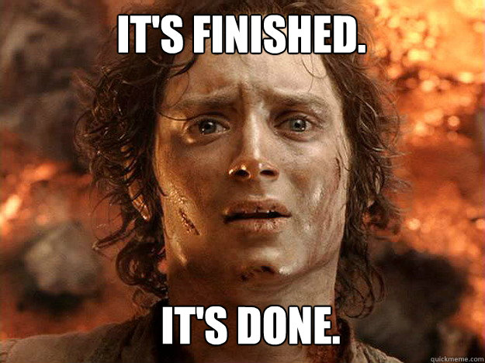
Questions?

